Slide 1
Designing for vulnerable and special needs groups

Slide 2
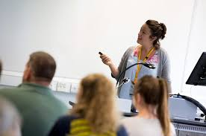
Learning outcomes
By the end of this lesson, students will:
Know who the vulnerable and special needs groups are.
Understand Why designing for the vulnerable and special needs groups?
Know the implication of not designing for them.
Understand how we can design for them.

Slide 3
Content
Who are the vulnerable and special needs groups?
Why designing for them?
What are the implications for not designing for them?
Effective ways for designing for them?
Conclusion.
References.

Slide 4
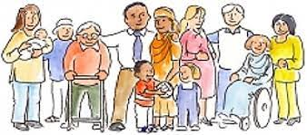
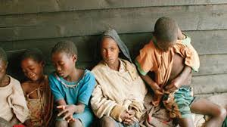
Who are the vulnerable and special needs groups?
Women who are very pregnant
People with dexterity problems
Elderly people
People with sensory disabilities both hearing and sight
People who are distracted or concentrating on something else
People with learning disabilities
The identified vulnerable groups
People who are in a hurry and not looking where they are going
People with neurological problems
People who have had an accident and are temporarily disabled
Young children
People with mental illnesses
People with heavy luggage
People who are not wearing their glasses that day
People who are physically disabled
(Osman & Gibberd, 2008).

Slide 5
Why designing for them?
Inclusivity: Referring to the stipulation in the government’s planning guidance on housing for older and disabled people, Housing link (2020) states that good housing design can help to create buildings and places that are for everybody.
To break down barriers: Designing for them can help to break down unnecessary physical and psychological obstacles as well as prohibitions caused by the poor design of buildings and places (Housing Link, 2020).
It was noted that everybody requires an inclusive environment with inclusive design that accounts for all the above users (Housing link, 2020)

Slide 6
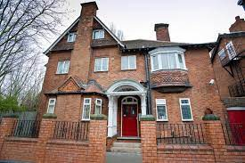
What are the implications for not designing for them?
Exclusion and inequality will be promoted: Everyone displaced deserve to be resettled successfully without been excluded or treated unequally. As the vulnerable and special needs group are not like everyone else, they are everyone else (Osman & Gibberd, 2008).
IMPLICATIONS
So, the need for inclusive environment that account and addresses the needs of the users is paramount (Osman & Gibberd, 2008),

Slide 7
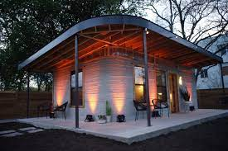
How can we design for them?
Understanding who these people are.
To design for the vulnerable and special needs groups requires:
Then mapping out design guidelines that specifies the right designs for the different vulnerable groups, a guideline that must be followed religiously.
Understanding their needs.
Knowing what works best for their comforts.
However, Housing Link (2020) note that there is a lack of relevant design guidance for the designers to follow. This lack is such that need to be addressed urgently to ensure that the vulnerable and special needs groups are provided with the best housing designs to enhance their quality of life

Slide 8
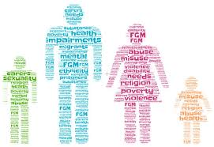
Conclusion
While it is accepted that different people may have different needs that are to be included into resettlement planning and designs:
It is important to note that some people are more vulnerable than the others.
And requires more well thought out designs than the rest.
Indeed, the vulnerable and special needs groups require supports which are somewhat different from the others.

Slide 9
References
Homeless Link (2013). Effective Action - RESETTLEMENT FROM HOMELESSNESS SERVICES. Resettlement Document. Available online at: https://www.homeless.org.uk/sites/default/files/site-attachments/Resettlement%20guidance.pdf. Assessed on: 17/01/2022.
Osman, A., & Gibberd, A. (2008). Housing for special needs: physical interior design to accommodate special needs.

