Slide 1
Managing Built Environment intervention

Slide 2
Learning outcomes
Define what managing built environment intervention is
Recognise the stakeholders of built environment interventions
Recognise the economics and financing of interventions
Recognise ethics and professionalism of built environment

Slide 3
Content
The stakeholders of Built Environment interventions
The economics and financing of interventions
Ethics and professionalism of Built Environment

Slide 4
The stakeholders of Built Environment interventions
The stakeholders of Built Environment interventions and stakeholders’ collective thinking on the contextual factors that influence the success and failures of built environment interventions (L.Firth, Stephens, Cantinotti, Fuller, Kestens, & Winters, 2021)
Many researchers have identified various stakeholders within the perspective of post natural disaster reconstruction (Shafique & Warren, 2016)
These stakeholders have their specific roles and interests in the project and based upon their interests and roles, researchers have divided stakeholders into various groups (Shafique & Warren, 2016)

Slide 5
Types of Stakeholders
Primary stakeholders - Essential for the project. The project could not proceed without their participation
Secondary stakeholders - Not essential but they have influence or are influenced by the project
Davis (2014) has classified stakeholders into the following:
Senior management: Board, directors, portfolio director, executive management, investors, executives, project executives, senior management, programme director, owner
Project core team: Project leader, manager, personnel, project team and its leader, other organizational involvements
Project recipients: Consumers, customers, clients, end users, users

Slide 6
Stakeholders of Built Environment intervention
Stakeholders should be engaged in reconstruction in a variety of ways ranging from planning and designing to its implementation and completion (Shafique & Warren, 2016)
Mojtahedi & Oo (2012) discuss about stakeholder’s approaches to natural disasters as follows;
Built environment stakeholders need to become more immersed in group decision making
Professional training for stakeholders such as architect, planners, engineers, developers, etc. pertinent to risk and hazard awareness should be systematically organized

Slide 7
Performance-based contracting, and product or service oriented procurement decision should be taken in order to make designers and contractors think about long-term implications and performance of buildings and structures they design and construct
Challenges in stakeholders of Built Environment interventions
According to Shafique & Warren (2016) in their study titled “Stakeholders and Their Significance in Post Natural Disaster Reconstruction Projects: A Systematic Review of the Literature” the challenges of stakeholders of Built Environment interventions are as follows;
Relationships among various stakeholders determine effective governance which is an important aspect to satisfy their potentially conflicting interests

Slide 8
The need to eliminate any clash of interests and improved coherence between stakeholders for better results
Stakeholders should improve coherence and the level of engagement to achieve perceived objectives
Communication with stakeholders and analyzing their needs as the most significant factor for stakeholder management (Shafique & Warren, 2016)
Researchers have determined that stakeholder engagement is very important for the success of a project. However, a practical approach based on scientific research for the engagement of stakeholders in a project still needed to be formulated (Shafique & Warren, 2016)

Slide 9
Economics and financing of interventions
Economic analysis involves comparing the costs and consequences of different interventions and enabling conclusions to be drawn about their relative efficiency (Hutton & Rehfuess, 2018)
This section will discuss about economics and financing of interventions along the following themes;
Whole life costing
Cost benefit analysis

Slide 10
Whole life costing
Whole life costing is defined as; ‘a technique for examining and determining all the costs – in monetary terms-direct and indirect, of designing, building and facility management (operating, maintenance, support and replacement) of a building throughout its entire service life including the disposal cost’ (Trusson, 2019)
In the built environment, whole life costing can be used to support the decision making process(Wong, 2010)

Slide 11
Cost benefit analysis
A cost-benefit analysis (CBA) is the process used to measure the benefits of a decision or action minus the costs associated with taking that action(Hayes, 2021)
In addition, Hutton& Rehfuess (2018) illustrated a step-by-step approach to cost–benefit analysis, from formulating a policy question to making a policy decision as follows

Slide 12
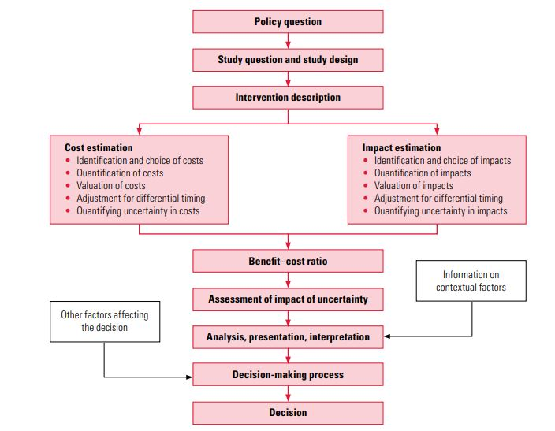
Step-by-step approach to cost–benefit analysis (Hutton & Rehfuess, 2018, p. 6)

Slide 13
Ethics and professionalism
Professional ethics is an act of “giving one’s best to ensure that client’s interests are properly cared for, but in doing so, the wider public interest is also recognized and respected” (Mooring, 2018)
It is the character by which a set of professionals are identified with; this also ensures some degree of commitment to excellence (Sharon, 2019)
All professional bodies in the built environment have agreed to conduct themselves in a manner which suggests the following (Sharon, 2019):

Slide 14
Honesty
Efficiency
Loyalty
Integrity
Competence
Confidentiality
Ensure safety, health and welfare of the public
Conduct themselves in such a way as to always enhance the reputation of the profession
Treat others with respect
Take responsibility
Only issue public statements in an objective and truthful manner(Sharon, 2019).

Slide 15
Case studies
Google Drive Link:
https://drive.google.com/drive/u/1/folders/1OjBOcrS4fOZTC7URm4HkFiY_Frbribj

Slide 16
References
Davis, K. (2014). Different stakeholder groups and their perceptions of project success. Retrieved 09 04, 2021, from International Journal of Project Management: http://dx.doi.org/10.1016/j.ijproman.2013.02.006
Hayes, A. (2021). Cost-Benefit Analysis. Retrieved 09 05, 2021, from Investopedia: https://www.investopedia.com/terms/c/cost-benefitanalysis.asp
Hutton, G., & Rehfuess, E. (2018). Guidelines for conducting cost-benefit analysis of household energy and health interventions. Retrieved 09 06, 2021, from World Health Organization: http://apps.who.int/iris/bitstream/handle/10665/43570/9789241594813_eng.pdf;jsessionid=757B712BABFD8509416105652D73147C?sequence=1
L.Firth, C., Stephens, Z. P., Cantinotti, M., Fuller, D., Kestens, Y., & Winters, M. (2021). Successes and failures of built environment interventions: Using concept mapping to assess stakeholder perspectives in four Canadian cities. Retrieved 09 03, 2021, from ELSVIER: https://www.sciencedirect.com/science/article/pii/S027795362030602X
Mojtahedi, M. S., & Oo, B. L. (2012). Stakeholders' approaches towards natural disasters in built environment: A theoretical framework. Retrieved 09 05, 2021, from ResearchGate: https://www.researchgate.net/publication/289059222_Stakeholders'_approaches_towards_natural_disasters_in_built_environment_A_theoretical_framework

Slide 17
Mooring, M. J. (2018). Professional Ethics. Retrieved 09 06, 2021, from Ireland: Society of Charterd Surveyors: https://www.gov.ie/en/organisation/department-of-education/?referrer=http://www.education.ie/en/Schools-Colleges/Services/National-Skills-Strategy/Submissions/NationalSkillsStrategy_Zoe-O-Connor_scsi.pdf
Shafique, K., & Warren, C. M. (2016). Stakeholders and Their Significance in Post Natural Disaster Reconstruction Projects: A Systematic Review of the Literature. Retrieved 09 03, 2021, from Canadian Center of Science and Education: http://dx.doi.org/10.5539/ass.v12n10p1
Sharon, J. T. (2019). Professional Ethics in the Built Environment and its Impact on Client Behavior. Retrieved 09 05, 2021, from ResearchGate: https://www.fig.net/resources/proceedings/fig_proceedings/fig2019/papers/ts04a_2/TS04A_2_jatau_fadason_et_al_9851.pdf
Trusson, M. (2019). Whole Life Costing of Sustainable Design. Retrieved 09 06, 2021, from Routledge: https://www.routledge.com/Whole-Life-Costing-for-Sustainable-Building/Trusson/p/book/9781138775558
Wong, I. L. (2010). Whole life costing: towards a sustainable built environment. Retrieved 09 07, 2021, from ResearchGate: https://www.researchgate.net/publication/224193330_Whole_life_costing_Towards_a_sustainable_built_environment

