Slide 1
Cultural sensitivity in housing design

Slide 2
Learning outcomes
By the end of this lesson, students will:
Understand the meaning of housing designs.
Understand what cultural sensitivity in housing designs means.
Identify the aim of culturally sensitive housing designs.
Understand the importance of creating culturally sensitive designs.
Know the requirements to creating culturally sensitivity housing designs.

Slide 3
Content
What is the meaning of Housing designs?
Define culturally sensitive housing designs.
The aim of culturally sensitive housing designs.
The importance of creating culturally sensitive designs.
The requirements of creating culturally sensitive housing designs?
Conclusion.
References.

Slide 4
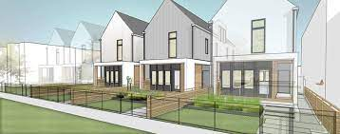
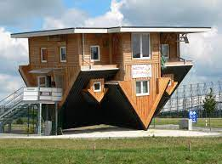
What is the meaning of Housing designs?
Housing designs
Housing design can affect the mental health of the people in many direct and indirect ways as such sociability is an important factor in designs (Lai & Rios, 2017)
The special beautification of the built environment to ensure it looks and functions in a certain way to enhance social cohesion, health and well being of the occupants. Housing design can be seen as housing quality and standards (Goodchild, 2021)

Slide 5
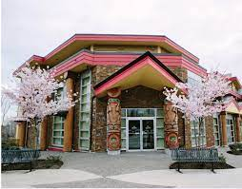
Culturally sensitivity housing designs
Culturally sensitive designs help to ease the adjustment process of new arrivals thereby contributing to the well-being of communities and the country.
Culturally sensitivity
Housing designs that accommodate the various individual cultures, values and way of living to create, maintain and pass on cultural identities across communities and generations bearing in mind the disparities in housing needs (Hadjiyanni, 2006).
In constructing the resettlement housing, it is important to be:
Culturally sensitive in the design of the housing especially because the housing is meant for people from diverse cultural backgrounds.
To note that people who are in love with cultural heritages, culturally sensitive designs may enhance their quality of life and be part of their recovery processes.

Slide 6
The aim of culturally sensitive housing designs
The aim of culturally sensitive housing designs is to:
Ensure the interactions between the environment, economy, society and culture in resettlement built environment.
Also allow cultural identities to be created, maintained, and pass on across communities and generations
(Rachelson, Wong & Han, 2019)

Slide 7
The importance of creating culturally sensitive designs
It raises cultural sensitivity and awareness which in turn enhances the society generally
It helps the people to adapt to local cultural values and norms with modem values.
I
M
P
O
R
T
A
N
C
E
It helps with cultural sustainability
It enhances social housing
A suitable internal layout of housing with some sense of cultural sensitivity plays a critical role in facilitating sustainable urban development
It create a built environment that enhances societal cultural heritage which is beneficial to the overall population and helps.the displaced to bounce back better.
(Aburounia. 2007; Rachelson, Wong & Han, 2019).

Slide 8
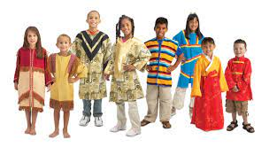
The requirement to achieve the culturally sensitive housing designs
To achieve this, there should be:
An understanding of cultural disparities in housing needs by the designers to develop residential models that can accommodate various individual values and ways of living.
Response to multiculturalism in housing designs.
Design education to prepare graduates for cross-cultural practice by engaging them to consider cultural difference (Hadjiyanni, 2006).

Slide 9
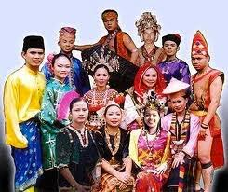
Conclusion
Culturally sensitive housing designs is important when it comes to resettlement.
To be able to create a culturally sensitive housing designs, the built environment professionals need to understand what constitutes cultural designs, and the appropriate culture of the displaced who are to be resettled.

Slide 10
References
Aburounia, H. M. A. (2007). The Internal Layout Design of Social Housing in Libya: A Cultural Value Perspective. Available online at: https://www.irbnet.de/daten/iconda/CIB22640.pdf. Assessed on: 11/12/2021..
Goodchild, B. (2021). Housing quality and design standards in England: the driving forces for change and their implications. People, Place & Policy Online, 15(1).
Hadjiyanni, T. (2006). Integrating social science research into studio teaching: housing new immigrants. Open House International.
Lai, L., & Rios, P. (2017). Housing Design for Socialisation and Wellbeing. Journal of Urban Design and Mental Health, 3, 12.
Rachelson, H.; Wong, J. & Han, E. (2019). An Exploration of Approaches to Advance Culturally-Appropriate Housing in Canada.Available onlie at: https://housingresearchcollaborative.scarp.ubc.ca/files/2019/06/Culturally-Appropriate-Housing-2019PLAN530-CMHC.pdf. Assessed on: 20/11/2021.

