Slide 1
RESETTLEMENT HOUSING

Slide 2
Learning outcomes
By the end of this lesson, students will:
Understand the meaning of resettlement housing.
Know the types of resettlement housing.
Recognise the importance of resettlement housing.
Understand the place of preparedness and planning in resettlement housing.
Understand how to plan a successful resettlement housing and the factors to consider.

Slide 3
Content
The meaning of resettlement and resettlement housing
Types of resettlement housing.
What are the importance of resettlement housing?
Why resettlement housing
.The place of preparedness and planning in resettlement housing.
How to plan a successful resettlement housing and the factors to consider

Slide 4
Meaning of resettlement & Resettlement Housing
R
E
S
E
T
T
L
E
M
E
N
T
Is a building or buildings created for the habitation of those who were rendered homeless by such factors as disasters and violent armed conflicts.
Resettlement housing
The act of moving homeless people from temporary housing or the streets into more permanent and frequently independent accommodation (Housing Link, 2013).
The planning of the housing “must” put into consideration the social and physical infrastructural needs of the displaced such as school and health services, access to employment opportunities, and housing (Perera, Weerasoori & Karunarathne, 2012).
The housing must be development oriented settlement.

Slide 5
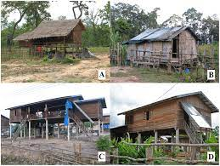
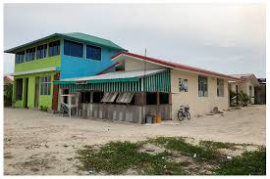
Types of resettlement housing
Temporal: People resettled in temporal places.
People moving from hostels to supported housing (Housing Link, 2013).
It was argued that an elongated residence in temporary places can increase the risk of expulsion and abandonment (Housing Link, 2013).
Transitional housing: It is a place where people stay while moving toward a more permanent housing - a second-stage housing; it acts as an intermediary between crisis housing and permanent housing, people here are preparing to be moved towards independent living (Weinreb, & Rossi, 1995; Jani, 2011).
Permanent: People resettled in permanent places.
This applies to mostly to protracted displacement: Displacement that lasts for a long time without solution at sight.

Slide 6
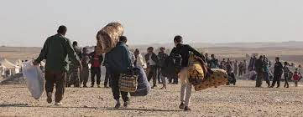
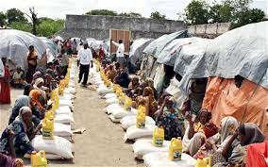
Why resettlement housing?
A lack of resettlement housing constitutes challenges and creates several risks (Homeless Link, 2013), to the displaced specifically and the humanitarian organisations in general.
Resettlement housing is among the central factors to the recovery process of the displaced.
It include supports to sustain people in their resettled places (Homeless Link, 2013).
It helps to reduce the vulnerability of the already vulnerable people.

Slide 7
The place of planning and preparedness in resettlement housing
Housing planning is a necessity in building resettlement houses: It helps to determine who needs temporal resettlement, transitional resettlement and who needs permanent resettlement.
In these unprecedented times of forced displacement induced challenges, it is expected that the built environment professionals in every city should have detailed plans to address the resettlement hosing needs of the displaced.
To this end, it can be argued that the provision should be made before the event rather the event before the provision. Then the question of how to plan successful resettlement housing arises.
Preparedness: preparedness in the part of the built environment professionals is as important as the resettlement itself.

Slide 8
How to plan successful Resettlement Housing and the factors to consider
The ways to plan a successful resettlement housing includes:
A direct investment in listening to and involving affected people so as to find solutions that meet their needs.
Identify and involve the appropriate primary and secondary stakeholders.
Adopt inclusivity approach – making provisions for the people with special needs.
Ensure equal distribution and access to resources.
Conducting risk assessment of the proposed resettlement environments.
Adequately addressing particularly, the basic needs of the resettled.
Factors to consider are:
Sustainability and resilience factors.
Environmental factors.
Socio-cultural factors to enhance social cohesion
Political factors – ensure the resettlement houses are not situated in an environment with the tendencies for violence and war.
Locational factors.
(The Howard League for Penal Reform, 2016; Otsuki, 2021. European Bank for Reconstruction and Development, N.D).

Slide 9
Conclusion
The provision of resettlement housing is one of the best supports that can be provided to the displaced. It is important to note that resettlement housing:
Can be temporal, transitional or permanent housing.
It includes the provision of all the necessary infrastructural facilities to the resettled.
It aims at reducing the vulnerability of the resettled.

Slide 10
References
European Bank for Reconstruction and Development (N.D). Resettlement Guidance and Good Practice. Available online at: file:///C:/Users/smart/Downloads/resettlement-guidance-good-practice%20(3).pdf. Assessed: 24/01/2022.
Homeless Link (2013). Effective Action - RESETTLEMENT FROM HOMELESSNESS SERVICES. Resettlement Document. Available online at: https://www.homeless.org.uk/sites/default/files/site-attachments/Resettlement%20guidance.pdf. Assessed on: 17/01/2022.
The Howard League for Penal Reform (2016). Resettlement Law guide. Available online: https://howardleague.org/wp-content/uploads/2016/04/Resettlement-law-guide.pd. Assessed on: 24/1/2022.
Jani, U. B. (2011). A Qualitative Analysis of Homeless Women with Children in Transitional Housing: What Are Their Needs?.
Perera, T. G. U. P., Weerasoori, I., & Karunarathne, H. M. L. P. (2012). An evaluation of success and failures in Hambantota, Siribopura resettlement housing program: lessons learned. Sri Lanka Journal of Real Estate, (6).
Otsuki, K. (2021). Making Justice the Subject of Resettlement Planning. Antipode, 53(6), 1745-1766.
UNHCR (2014). PLANNED RELOCATION, DISASTERS AND CLIMATE CHANGE: CONSOLIDATING GOOD PRACTICES AND PREPARING FOR THE FUTURE. Available online at: https://www.unhcr.org/54082cc69.pdf. Assessed on: 18/01/2022.
Weinreb, L., Rossi, P., (1995). The American homeless family shelter “system”. Social Service Review, 69(1), 86-107.
.

