Slide 1
Links between Disaster resilience and displacement

Slide 2
Learning outcomes
At the end of the lecture, students will:
Understand the meaning of resilience.
Understand the meaning of disaster resilience.
Know the meaning of displacement.
Understand the relationship between disaster resilience and displacement.
Know the importance of disaster resilience to reducing displacement.

Slide 3
Content
The meaning of resilience.
The meaning of disaster resilience.
The meaning of displacement.
The relationship between disaster resilience and displacement.
The importance of disaster resilience to reducing displacement.
Conclusion
References.

Slide 4
The meaning of resilience
Resilience has to do with the ability to withstand shocks and stresses.
In explaining resilience, it was noted that resilient communities and individuals have the capacity to withstand shocks and stresses resulting from disasters and displacement.
Importantly, these set of people are said to have some degree of capacity to access quick solution to their displacement with reduced losses to their social networks, financial and physical assets, or general well-being (Pinto et al., 2014
Resilience = disaster risk reduction + climate change adaptation + poverty reduction” (UNHCR, 2015).

Slide 5
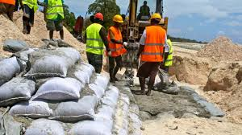
The meaning of disaster resilience
As the name implies is the ability or capacity to withstand the consequences of disaster and bounce back better afterwards (Arup, 2014: Amaratunga, Sridarran & Haigh, 2019).

Slide 6
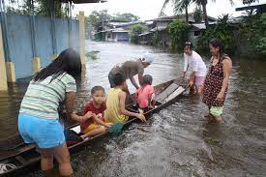
Displacement & Vulnerability
Displacement is a consequent of vulnerability, vulnerability is the consequence of the lack of resilience, the lack of resilience increases vulnerability to displacement, then displacement reduces resilience and increases vulnerability (Pinto et al., 2014).
These concepts relates to each other in one way or the other

Slide 7
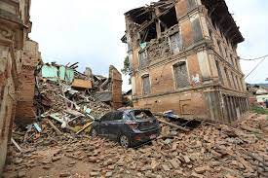
The relationship between disaster resilience and displacement
Disaster resilience and displacement can be said to be interrelated and multifaceted (Pinto et al., 2014).
When resilience decreases, displacement risks increase with every shock and stress (Schrepfer & Caterina, 2014) .
To explain this further, Schrepfer & Caterina (2014) put forth an equation which is “Displacement = hazards (causes + drivers) + vulnerability Capacity + innovation”.
This shows that the lack of resilience is central to the trigger of vulnerability and the cause of displacement.

Slide 8
Disaster resilience in reducing displacement
The creation of disaster resilient measures in cities can help to reduce vulnerability and prevent further displacements.
It means: to reduce displacement, increase resilience.
It is imperative that humanitarian, development, and displacement organizations adapt to solutions that can increase the resilience of vulnerable populations to prevent further displacement (Pinto et al.,14).
To achieve disaster resilience and reduce displacement, resilience planning should consider long-term urban resilience issues such as climate change impacts while creating resilience to reduce vulnerability (Arup, 2018).

Slide 9
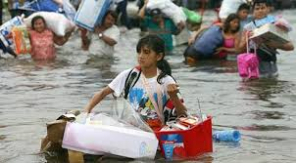
Conclusion
The link between disaster resilience and displacement has been made clear
It can be noted that the built environment professionals should focus on building disaster resilience infrastructure targeted at reducing the risks of displacement via the reduction of vulnerabilities.

Slide 10
References
.
Amaratunga, D., Sridarran, P., & Haigh, R. (2019). Making Cities Resilient Report 2019: A snapshot of how local governments progress in reducing disaster risks in alignment with the Sendai Framework for Disaster Risk Reduction.
ARUP. (2014). City resilience framework; Index, City Resilience. The Rockefeller Foundation and ARUP.
Pinto, G. M., Attwood, J., Birkeland, N., & Nordbeck, H. S. (2014). Exploring the links between displacement, vulnerability, resilience. Procedia Economics and Finance, 18, 849-856.
Schrepfer, N., & Caterina, M. (2014). On the Margin: Kenya’s Pastoralists–From displacement to solutions, a conceptual study on the internal displacement of pastoralists. Internal Displacement Monitoring Centre: Geneva Switzerland. ht tp://www. internal-displacement. org/assets/publications/2014/201403-af-kenya-onthe-margin-en2. pdf.
UNHCR (2015). COMMUNITY RESILIENCE AND DISASTER-RELATED DISPLACEMENT IN SOUTH ASIA. Available online at: https://www.sheltercluster.org/sites/default/files/docs/resilience-and-disaster-related-displacement-in-south-asia.pdf. Assessed on: 13/01/2022.

