Slide 1
Challenges to host Cities and Urban systems

Slide 2
Learning outcomes
By the end of this lesson, students will:
Know the Statistics of displacement.
Know the meaning of host cities.
Understand Urban systems
Know the Challenges to host cities and urban systems.
Know the triggers of these challenges.
Know way to address the challenges.

Slide 3
Content
Statistics of mass displacement.
The host cities
Urban systems
Challenges to host cities and urban systems
The triggers of these challenges.
Addressing the challenges.
Conclusion.
References.

Slide 4
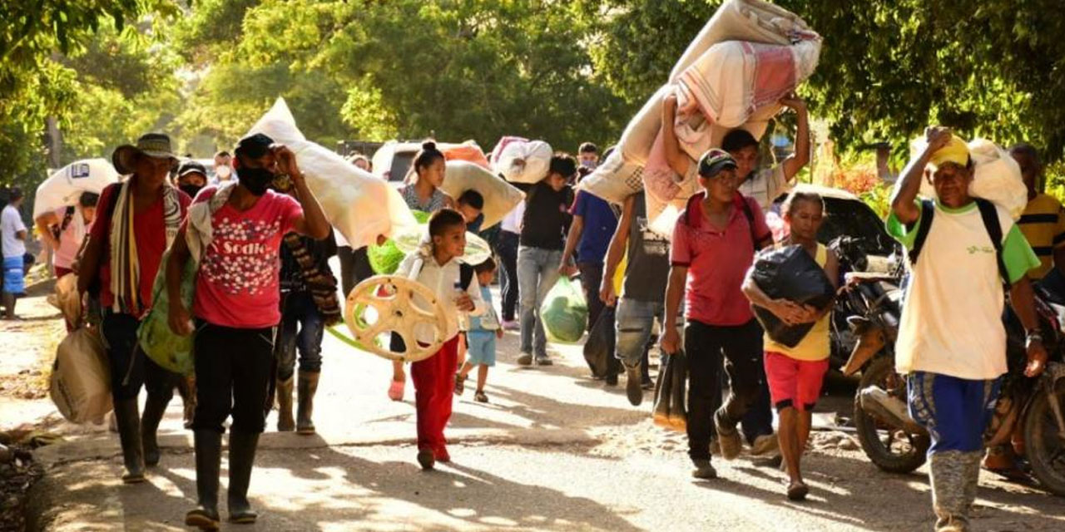
Statistics on mass displacement
Mass displacement is an issue that affects cities globally.
Over 60% of the world’s 19.5 million refugees and 80 per cent of 34 million IDPs live in urban environments (UNHCR, 2017).
This constitutes enormous challenges to the host cities and urban systems.

Slide 5
The host cities
Host cities
There seem to be no generally acceptable definition of host cities, however, it can be seen as those cities that welcomes and accommodate the displaced as well as share their infrastructure and resources with them.
Host families
Host families in urban environments - Are those individuals in cities who share their accommodation and resources with the displaced people (Jordan, 2019)
According to Jordan (2019), hosting practices are more diverse than the way it is currently represents; hosting involves counterfeiting relationships between the unrelated persons and offering protection, belonging and identity, as well as meeting basic needs of those individuals who share their accommodation and resources with displaced people (Jordan, 2019).
Thus, hosting the displaced in cities overburdens the urban systems.

Slide 6
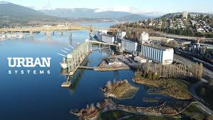
Urban systems
Urban system is an all-inclusive collection of cities that are interdependent through economic oscillations, diffusion and exchange of information, and flow of goods, capital and people (Pred, 2017).
Murayama advanced that cities which are part of such an interdependent system change in response to growth or decline in other cities and do not grow, stagnate, and decline independent of one another (Murayama,2000).
Urban systems is not concerned with the spatial expansion of the cities or its internal structure; rather, it emphasizes interurban relationships by viewing cities as points in a network.

Slide 7
The performance of the urban systems
The performance of an urban system depends on the functionality of the sub-systems of which it comprises:
Water
Energy
Economic
Socio-cultural etc
The functionality of those sub-systems depends on their physical, human and natural assets, knowledge and behaviours and finance and governance structures, how equipped these are to manage and adapt to shocks and stresses and the sub-system’s dependence on other systems for continued performance (Arup, N.D).

Slide 8
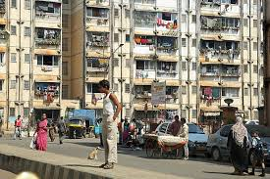
Challenges to host cities and urban systems
Forced displacement is challenging to host communities/cities (Verme, Paolo; Schuettler, Kirsten, 2019), and the urban systems.
Lack of employment and livelihoods
Pressure on valuable resources such as land, water, and fuel.
Inadequate housing and tenure security
Pressures on infrastructure
Challenges
Increased tensions between refugees and their host
Inadequate provision of basic services
The host communities stereotyping the displaced as lazy people who are prone to criminality
Trauma and deprivation (UNHCR, 2016).
Pressure on the functionality of the urban and sub-urban systems
(Global Protracted displacement, ODI case studies. 2015; UNHCR, 2016; Kirbyshire, Wilkinson, Le Masson & Batra, 2017)

Slide 9
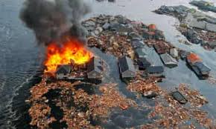
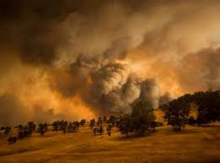
Triggers of these challenges
The factors that exacerbates these challenges:
The lack of capacity to withstand the two types of shocks namely:
Expenditure shocks determined by the increased financial flows that a forced displacement Crisis may attract
Population shock with a sudden increase in population triggered by an inflow in a particular geographical area
The population shock and expensive shocks are important shocks that are worthy of note in this study materials as they pose significant challenges to the host cities and urban systems.
(Verme et al.., 2019)

Slide 10
Addressing these challenges
Address the triggers of the challenges: create urban sustainability and resilience.
A city’s ability to respond to a shock event depends on the ability of the existing systems which underpin urban well-being to be able to continue to function under additional stress, and/or the ability of new avenues of support to be able to effectively work with, or within, existing urban systems (ARUP, N.D).
Based on the above, the built environment professionals and all the body concerned should put more efforts in infrastructure and service provision for the displaced and the host cities as well as ensure the functionality of the existing urban systems via the creation of urban sustainability and resilience.

Slide 11
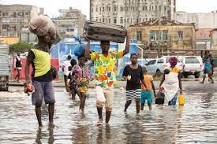
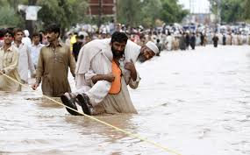
Conclusion
Indeed, the lists of the challenges of displacement to the host cities and urban systems can be inexhaustible.
It is a call to action to all the built environment professionals to adopt a more detailed action towards addressing these challenges.

Slide 12
References
ARUP (N.D). MASS DISPLACEMENT Host Cities and Urban Systems. Available at: file:///C:/Users/smart/Downloads/MassDisplacementhostcitiesandurbansystems%20(3).pdf. Assessed on: 28/01/2022.
Global Protracted displacement, Odi case studies (2015). Protracted displacement Uncertain paths to self-reliance in exile; Annex 8 - Case studies: Colombia, Darfur, Jordan and Uganda. Available at: https://www.internal-displacement.org/sites/default/files/inline-files/201509-global-protracted-displacement-odi-case%20studies.pdf. Assessed on: 12/01/2022.
Jordan, Z. (2019). Displaced in cities: Who are the hosts? Humanitarian law and Policy Blog. Available online at: https://blogs.icrc.org/law-and-policy/2019/02/12/displaced-cities-who-are-hosts/. Assessed on: 27/01/2022.
Kirbyshire. A, Wilkinson. E, Le Masson and Batra. P. (2017). Mass displacement and the challenge for urban resilience. ODI, London. [https://www.odi.org/sites/odi.org.uk/files/ resource-documents/11202.pdf ]
Murayama Y. (2000) Study of Urban Systems: Outcomes and Issues. In: Japanese Urban System. The GeoJournal Library, vol 56. Springer, Dordrecht. https://doi.org/10.1007/978-94-017-2006-9_2.
Pred, A. (2017). City-systems in advanced economies: past growth, present processes and future development options. Routledge.
UNHCR, 2016b, New York Declaration Annex I: COMPREHENSIVE REFUGEE RESPONSE FRAMEWORK Draft for Adoption. Available at: http://www.un.org/en/development/desa/population/ migration/events/ga/documents/2016/1August2016/AnnexI_ refugeeframework.pdf
Verme, Paolo; Schuettler, Kirsten. (2019). The Impact of Forced Displacement on Host Communities : A Review of the Empirical Literature in Economics. Policy Research Working Paper;No. 8727. World Bank, Washington, DC. © World Bank. https://openknowledge.worldbank.org/handle/10986/31231 License: CC BY 3.0 IGO.

