Slide 1
Lessons learned through Case studies

Slide 2
Learning outcomes
By the end of this lesson, students will understand the lessons from case studies such as:
Lesson 1: Strained and inadequate infrastructure.
Lesson 2: Late response to displacement emergencies.
Lesson 3: Lack of IDPs camps.
Lesson 4: IDPs renting houses for themselves.
Lesson 5: Difficulty in identifying the displaced.
Lesson 6: Short term measures.

Slide 3
Content
Lesson 1: Strained and inadequate infrastructure.
Lesson 2: Late response to displacement emergencies.
Lesson 3: Lack of IDPs camps.
Lesson 4: IDPs renting houses for themselves.
Lesson 5: Difficulty in identifying the displaced.
Lesson 6: Short term measures.
Conclusion.
References.

Slide 4
Lesson 1: Strained and inadequate infrastructure
.
One of the lessons learned in displacement and resettlement is that most countries witnesses strained and inadequate infrastructural facilities that seems to remain unaddressed.
Regarding health care facilities, Ferris (2009), notes that an overwhelming majority of the displaced in host communities in Mardan and Swabi districts of the researched areas suffers from diarrhoeal and other health problems after displacement.
Ferris (2009) who researched on the displacement in Pakistani, revealed that one of the challenges of displacement there is strained infrastructure which includes increased demands for health care, for sanitation, for water and this overwhelmed the capacity of local infrastructure

Slide 5
Lesson 2: Late response
Case studies revealed that there has been late responses to forced displacement and resettlement thereby necessitating the need for quick and early responses at a time that it is needed most.
Recalling what happened in a particular case study, Ferris (2009) state that there is the lack of quick response in attending to the needs of the displaced and according to Ferris, displacement is an emergency which requires immediate response.
This is worthy of note and action by the built environment professionals.

Slide 6
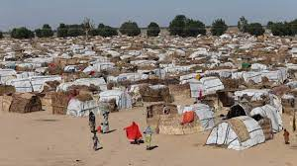
Lesson 3: Lack of IDPs camp
Case studies reveals that most countries cannot support the displaced adequately as a result of the lack of IDPs camps
This is a bitter instance that requires not to repeat itself elsewhere.
Lack of IDPs camps:
What happened in Colombia where it was noted that there were no displacement camps and collective centres apart from some small-scale sites serves as a huge lesson (Global Protracted displacement, Odi case studies, 2015)

Slide 7
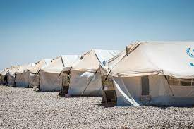
Lesson 4: IDPs renting houses for themselves
It is well documented that displacement and resettlement is a humanitarian and development challenge, meaning that the humanitarian organisations need to put in efforts to take adequate actions to resettle the displaced.
Case studies reveal that some IDPs resettled themselves by renting their own accommodation.
Ferris (2009), explained that some IDPs in urban areas have to rent accommodation and some others have to set up home in informal settlements with poor access to public services and inadequate tenure security.

Slide 8
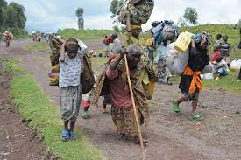
Lesson 5: Difficulty in tracing and identifying the displaced
It was noted in some case studies that that it was difficulty to locate most of the displaced who resettled themselves by renting their own accommodation, a situation that need to be avoided by every means possible.
Most urban displaced become largely invisible among the poorest and most vulnerable members of the general population, thereby making it difficult to identify them and address needs related to their displacement (Ferris, 2009).

Slide 9
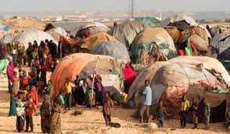
Lesson 6: Short term measures
According to Kelly (2017), the reflection on the early years of the Syrian crisis revealed that the short term planning measures adopted to address the challenges emanating from the crises was flawed and inadequate. This is perhaps because of the increasing protracted displacement with elongated challenges that cannot be adequately addressed via short term planning.
Another important lesson learned from the case study of the Syrian crises is the challenges that emanates from the short-term planning.
Based on this, it becomes important to adopt the recommendation of the UN-Habitat that countries should start adopting long term measures in addressing the challenges of displacement (UN-Habitat, 2020).

Slide 10
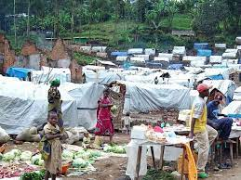
Conclusion
The various lessons learned from case studies have highlighted the areas that need to be improved upon going forward in issues of displacement and resettlement.
As a result the built environment professionals as well as other humanitarian organisations should act on these lessons to ensure that the displaced are not left at the mercies of their own vulnerabilities.

Slide 11
References
Ferris (2009) Pakistani Displacement: Lessons Learned from Other Mass Displacement Situations. Available online at: https://www.brookings.edu/on-the-record/pakistani-displacement-lessons-learned-from-other-mass-displacement-situations/. Assessed on: 12/01/2022).
Global Protracted displacement, Odi case studies (2015). Protracted displacement Uncertain paths to self-reliance in exile; Annex 8 - Case studies: Colombia, Darfur, Jordan and Uganda. Available at: https://www.internal-displacement.org/sites/default/files/inline-files/201509-global-protracted-displacement-odi-case%20studies.pdf. Assessed on: 12/01/2022.

