Slide 1
Introduction to Mass Displacement
Module 3: The Context of Mass Displacement

Slide 2
Content
Introducing the displaced
Causes, contexts and dynamics of mass displacement
Legal, policy and institutional frameworks
Stakeholders of mass displacement
Summary
Notes:
Module Rationale: The Context of Mass Displacement
Module 2 ended by briefly introducing the concept of mass displacement - the “movement of persons who have been forced or obliged to flee or to leave their homes or places of habitual residence, in particular as a result of or in order to avoid the effects of armed conflict, situations of generalized violence, violations of human rights or natural or human-made disasters”.¹
This Module will dive deeper into the concept of mass displacement, introducing some of its causes, contexts and dynamics in greater detail. We will build upon the realization presented at the end of Module 2, namely that, although rigid categorizations ill fit the complexities of people’s lives, some categories are actually needed, and we will look upon why this realization is relevant in the context of mass displacement. The module will furthermore present some of the many legal, policy and institutional frameworks which cover the rights of displaced people and how international stakeholders may act in relation to them. Some important international stakeholders who work more closely with displaced populations will also be presented in greater detail.

Slide 3
1. Introducing the displaced Refugees and Internally Displaced Persons
Section 1. Introducing the displaced
Displaced persons | Persons or groups of people who have been forced or obliged to flee or to leave their homes or places of habitual residence, either across an international border or within a State, in particular as a result of or in order to avoid the effects of armed conflict, situations of generalized violence, violations of human rights or natural or human-made disasters.
Refugees under UNHCR mandate (includes both refugees and people in refugee-like situations)
Palestinian refugees under UNRWA mandate
Asylum seekers
Venezuelans displaced abroad
Internally displaced people
Stateless people
Refugee returnees
IDP returnees
Others of concern to the UNHCR
Population of concern to the UNHCR
Displaced persons
Notes:
Introducing the displaced
The previous module finished off by introducing the terms displacement and displaced persons, and highlighted that these concepts are highly linked to the idea that certain types of movement are forced or coerced. Module 2 moreover highlighted that, although defined categories rarely fit the complexities of people’s lives, they are useful and in certain cases even needed, as they have bearings on the obligations of the state and on the international community. These two statements bring us to the purpose of the first section in this module, namely to introduce the displaced persons (or as some call them, displacees) in greater detail. We will soon realize that displaced persons can be referred to in a number of ways, that there are fine but important lines between these various ways of referring to displaced persons, and that these categories indeed have a bearing on how international actors may respond to people in need.
The above visual displays the various categories of people who are under the mandate of the United Nations High Commissioner for Refugees (UNHCR), the UN refugee agency². These cover populations for whom the UNHCR has been entrusted with a responsibility by the international community, and include both displaced persons and other populations of concern to the agency. In this module we will focus on the categories refugee and internally displaced person (IDP) in greater detail. In the next slide, we will look at some various definitions of these categories.

Slide 4
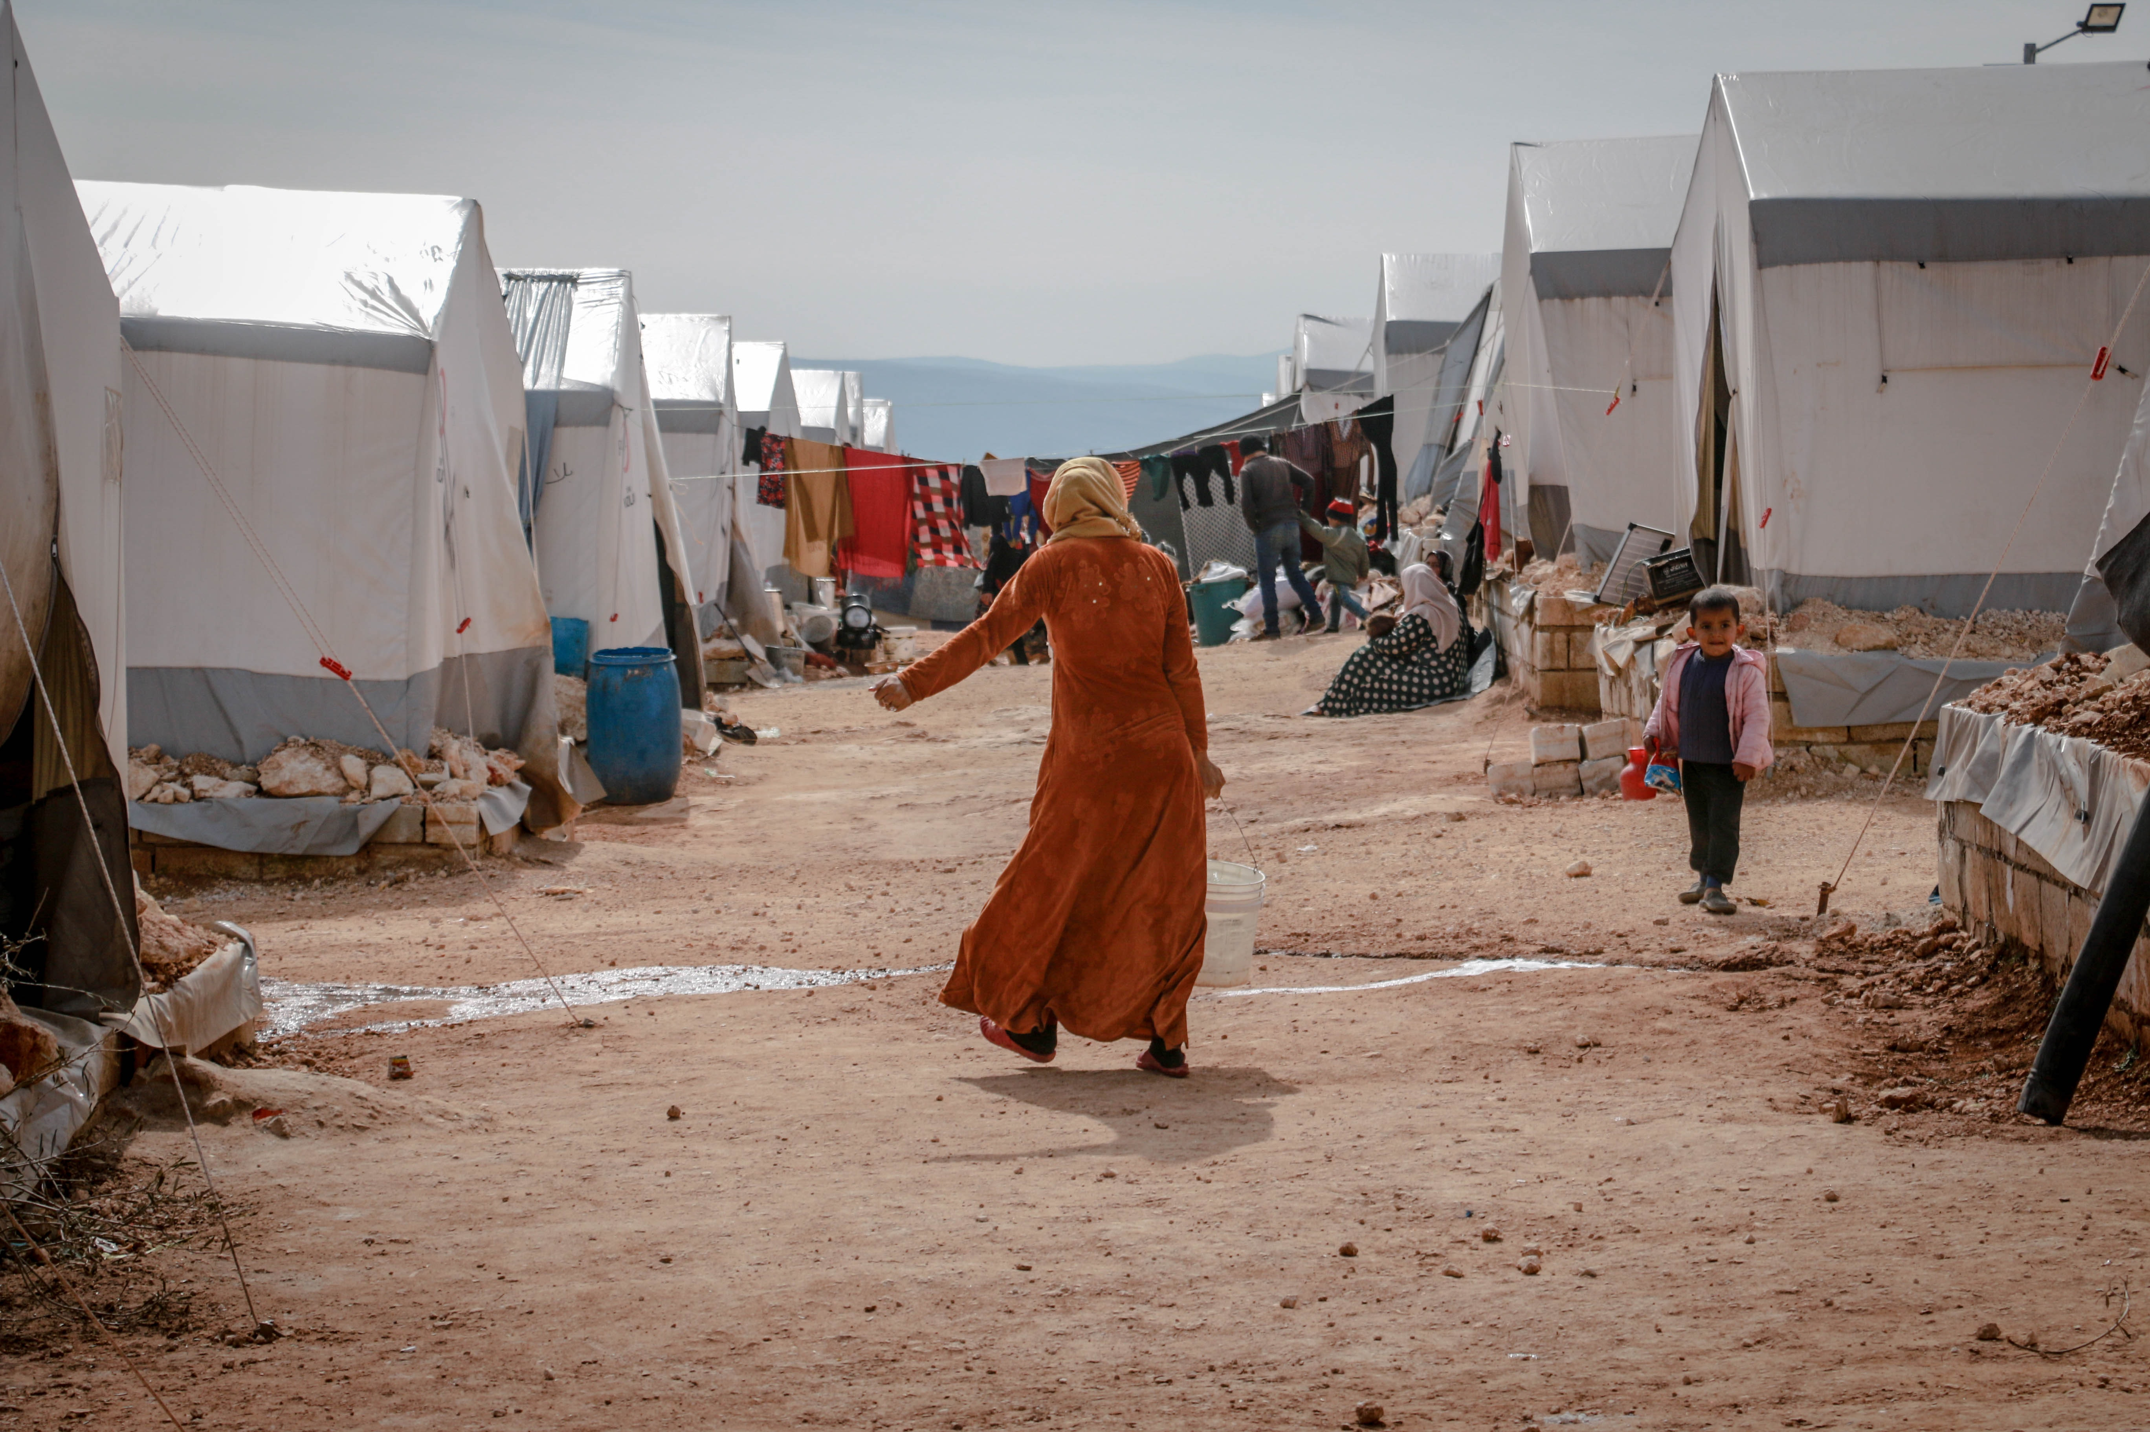
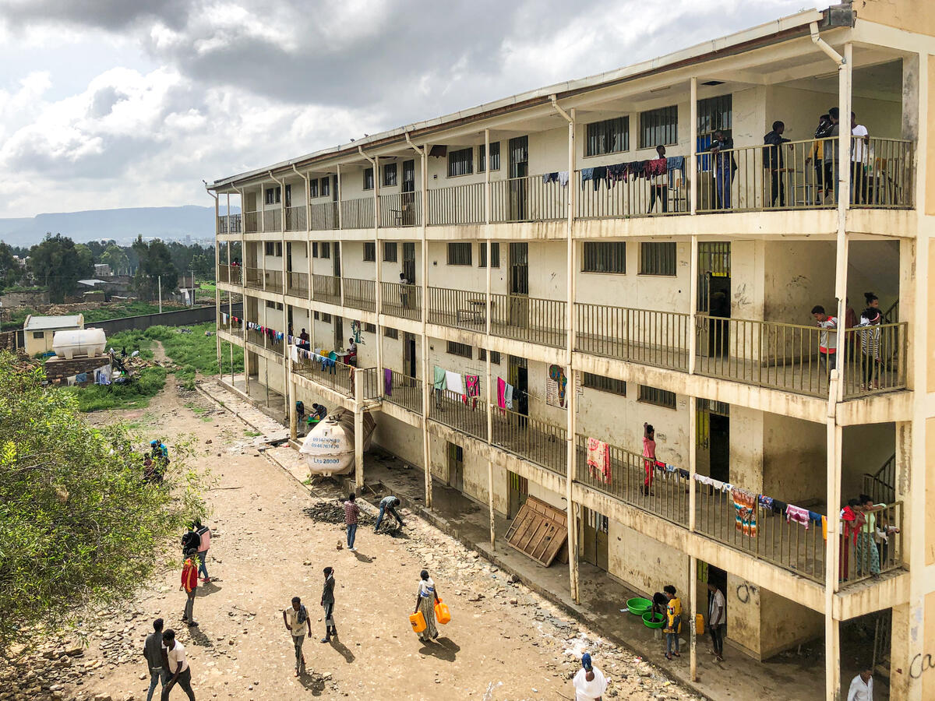
1. Introducing the displaced What is a refugee? And what is an internally displaced person?
Section 1. Introducing the displaced
Refugee camp in Idlib, Syria
Photo credit: Ahmed Akacha (https://www.pexels.com/sv-se/foto/vag-solig-kvinna-smutsig-6918512/)
Ethiopia. School in Mekele hosts internally displaced families by the Tigray conflict
Photo credit: © UNHCR Image - RF1163318 (UNHCR Refugees Media)
Notes:
What is a refugee? And what is an internally displaced person?
In its Glossary on Migration, the International Organization for Migration (IOM) presents various definitions of what constitutes a refugee, which can be found in various international legal and policy documents. Perhaps the most important of these is the definition found in the 1951 Convention relating to the Status of Refugees, which states that a refugee is “a person who, owing to a well-founded fear of persecution for reasons of race, religion, nationality, membership of a particular social group or political opinion, is outside the country of his nationality and is unable or, owing to such fear, is unwilling to avail himself of the protection of that country; or who, not having a nationality and being outside the country of his former habitual residence as a result of such events, is unable or, owing to such fear, is unwilling to return to it”.³
Other definitions may be found in the UNHCR Handbook and Guidelines on Procedures and Criteria for Determining Refugee Status from 2011, which stipulates that a refugee is “a person who qualifies for the protection of the United Nations provided by the High Commissioner for Refugees (UNHCR), in accordance with UNHCR’s Statute and, notably, subsequent General Assembly’s resolutions clarifying the scope of UNHCR’s competency, regardless of whether or not he or she is in a country that is a party to the 1951 Convention or the 1967 Protocol – or a relevant regional refugee instrument – or whether or not he or she has been recognized by his or her host country as a refugee under either of these instruments”⁴ and in the UNHRC Master Glossary of Terms, which describes refugees as “persons recognized as refugees, by a state or the United Nations High Commissioner for Refugees, on the basis of objective criteria related to the circumstances in their country of origin, which justify a presumption that they meet the criteria of the applicable refugee definition”.⁵ Although compiled in one source by the IOM, these definitions stem from different important international policies on refugees which will be mentioned in more detail later on in this module.
The International Organization for Migration furthermore highlights two important points to remember with regards to the status of refugees:
The first point is that, under international refugee law, recognition as a refugee is declaratory and not constitutive. “A person is a refugee within the meaning of the 1951 Convention as soon as he fulfils the criteria contained in the definition. This would necessarily occur prior to the time at which his refugee status is formally determined. Recognition of his refugee status does not therefore make him a refugee but declares him to be one. He does not become a refugee because of recognition, but is recognized because he is a refugee”.⁶
The second point is that refugee status must be determined on an individual basis, although mass populations may become refugees: “While refugee status must normally be determined on an individual basis, situations have also arisen in which entire groups have been displaced under circumstances indicating that members of the group could be considered individually as refugees. In such situations the need to provide assistance is often extremely urgent and it may not be possible for purely practical reasons to carry out an individual determination of refugee status for each member of the group. Recourse has therefore been had to so called ‘group determination’ of refugee status, whereby each member of the group is regarded prima facie (i.e. in the absence of evidence to the contrary) as a refugee”.⁷
In a similar manner, the term internally displaced person is defined as “persons or groups of persons who have been forced or obliged to flee or to leave their homes or places of habitual residence, in particular as a result of or in order to avoid the effects of armed conflict, situations of generalized violence, violations of human rights or natural or human-made disasters, and who have not crossed an internationally recognized state border”.⁸ This definition is adopted in the UNHCR Guiding Principles on Internal Displacement. The Guiding Principles are not legally binding, but they have become an authoritative reference on how states should respond to internal displacement and therefore have at least moral bearing on the behaviour of states.

Slide 5
1. Introducing the displaced Questions for reflection
Section 1. Introducing the displaced
What are some of the key features you see in the definitions of what constitutes a refugee and what constitutes an internally displaced person?
Do you find any important differences between the definitions? If so, can you reflect on why these differences exist?
Notes:
Refugee or internally displaced person – What difference does it make?
The terms refugee and internally displaced person are not only empirical descriptions capturing the conditions of a person’s displacement. The legal and policy frameworks within which the previously-mentioned definitions are included have a bearing on the actions and behaviour of single states as well as the international community, whether this be morally or legally. To illustrate, while the 1951 Convention relating to the Status of Refugees on the one hand has legal bearing on 149 party states and is the key legal documents that form the basis of the work of the UNHCR⁹, the Guiding Principles on Internal Displacement on the other hand are not legally binding, although it is an authoritative moral force with respect to the behaviour of states.
Some aspects should be highlighted with regards to the questions for reflection above and the key differences between what constitutes a refugee and what constitutes an internally displaced person:
Whether the displacee has crossed a country border or not is decisive in this case and determines the status of the displaced as a refugee or internally displaced person. Refugees are people that have been displaced across a country border, while internally displaced people remain within the borders of their usual country of residence.
The status of the displaced determines what national and international legal and policy sources apply to the displaced.
What national and international legal and policy sources apply to the displaced has a bearing on the obligations of the state and the international community towards the displaced.
Thus, the rights of displacees and what help they may receive from the state or the international community are to a large extent dependent on their status and whether they have crossed a border of its own state. These statuses say nothing about the actual distance the displacee has travelled from his or her usual place of residence nor does it say anything about the needs of the displacee. They just highlight the importance of the state border in international politics.

Slide 6
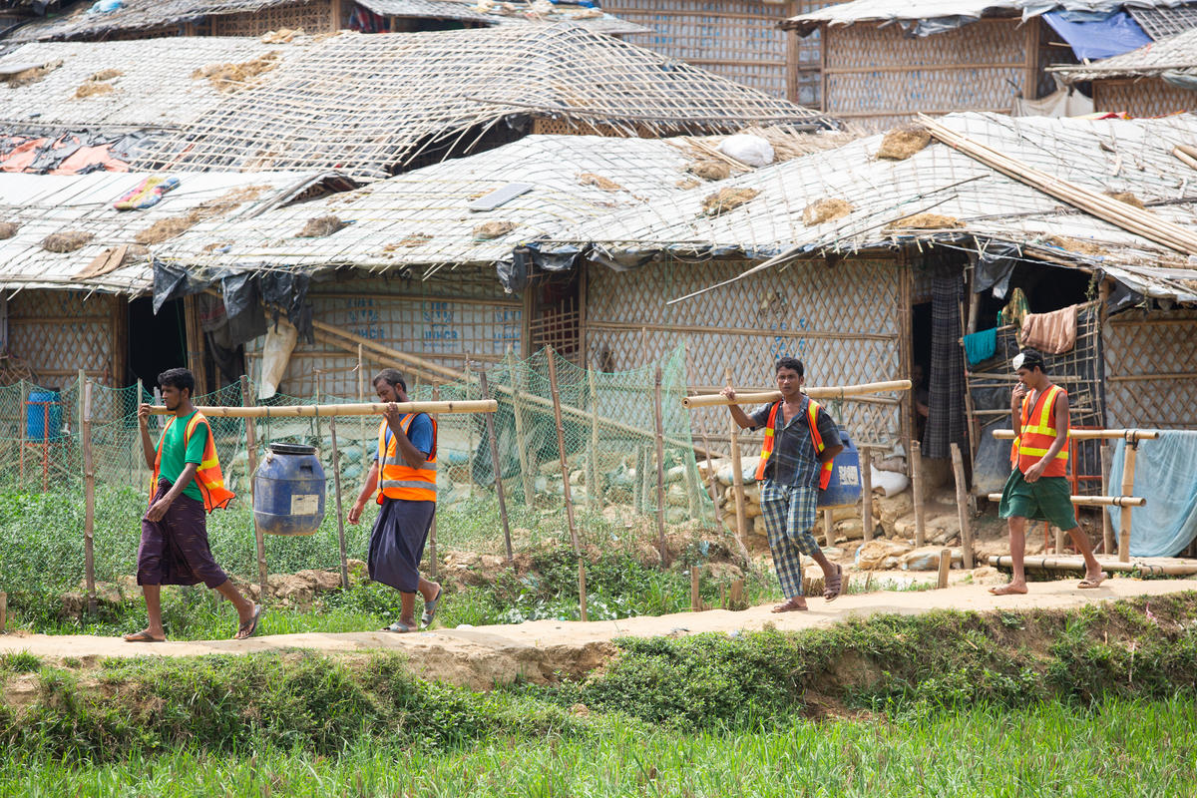
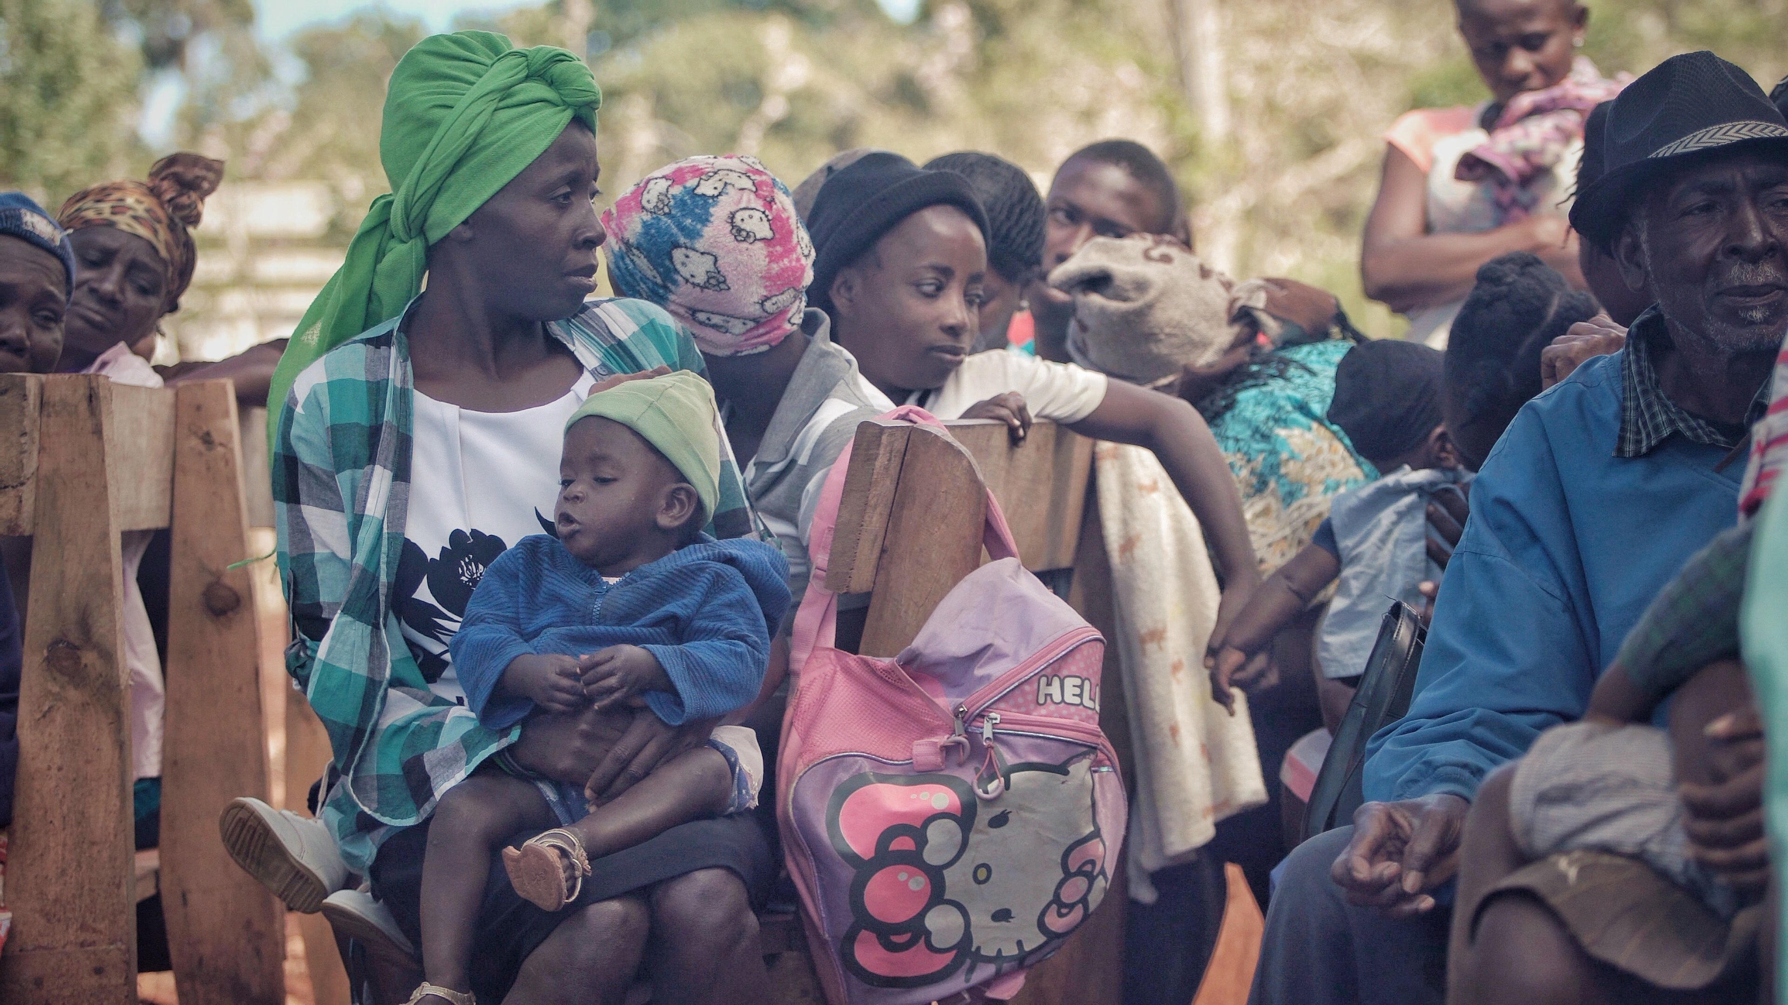
2. Causes, contexts and dynamics of mass displacement The causes of mass displacement
Section 2. Causes, contexts and dynamics of mass displacement
Refugee camp in Idlib, Syria
Photo credit: Ahmed Akacha (https://www.pexels.com/sv-se/foto/vag-solig-kvinna-smutsig-6918512/)
Bangladesh. Kutupalong camp for Rohingya refugees in Cox’s Bazar
Photo credit: © UNHCR Image - RF2228817 (UNHCR Refugees Media)
Haiti was in 2010 subject to a massive earthquake which forced 1.5 millions Haitians to leave their homes
Photo credit: Zach Vessels on Unsplash (https://unsplash.com/photos/fA29oQ0cpcY)
Notes:
The causes of mass displacement
As we have learned in the previous two modules, people both move and stay in place because of a plethora of various reasons, whether these reasons be political, economic, social or environmental in nature. This is true also for forcibly displaced persons. When we talk about mass displacement, the displacement can also often be traced back to one major event or factor, an event or factor which made a large number of people take (either voluntary or involuntary) the decision to move simultaneously.
In migration studies, a distinction is often made between conflict-induced and disaster-induced displacement, where conflict-induced displacement is referred to as caused by humans, and disaster-induced displacement have natural hazards causes. Stephen Castles, in his article on global perspectives on migration, highlights some various causes for displacement and various types of displaced persons, in addition to people being displaced by violence and armed conflict:¹⁰
The category environmental displacees refers to people displaced by environmental change (such as desertification, deforestation, land degradation, water pollution or inundation). While environmental factors do play a part in forced migration, displacements due to environmental factors are also often closely linked to other factors, such as social and ethnic conflict, weak states, inequitable distribution of resources and abuse of human rights. It may thus be difficult to define who is an environmental displacee, or to quantify this category in any meaningful way. The emphasis on environmental factors can moreover be a distraction from central issues of development, inequality and conflict resolution.
Disaster displacees covers people forced to move by hazards induced disasters (for instance floods, hurricanes, volcanoes, earthquakes, landslides) or disasters resulting from human activities (e.g. industrial accidents, environmental pollution, radioactive emissions). Displacement by disasters has become increasingly significant to humanitarian agencies, following the great loss of life and destruction caused by disasters such as the 26 December 2004 tsunami that hit Asian countries, the hurricanes in the USA in September 2005, and the earthquake in Pakistan in October 2005. Problems of humanitarian assistance in such major emergencies are in many ways similar to those caused by conflicts, and often the same relief organizations are involved.
Development displacees are people compelled to move by large-scale development projects, such as dams, airports, roads, conservation areas and urban housing. The acronym DIDR is used to refer to ‘development induced displacement and resettlement. Typically, it is rural dwellers, ethnic minorities and indigenous people who suffer ‘in the national interest’, while elites and transnational companies benefit. Many development displaces therefore experience permanent impoverishment, and end up in situations of social and political marginalization. Many of these displacees end up drifting into urban slums, or becoming a part of floating populations, which may spill over into international migration.

Slide 7
2. Causes, contexts and dynamics of mass displacement Questions for reflection
Section 2. Causes, contexts and dynamics of mass displacement
What reasons for displacement can you discern in the examples presented on the previous slide?
What do these displaced populations have in common? And what differentiates them from each other?
Can you reflect on the various needs and capacities of these displaced persons? What factors influence their capacities?
Notes:
Modern-day examples of mass displacement
The previous slide presented some examples of mass displacement of people which have all occured within the past decade or two, and which have frequently been reported by the media. Before you read the brief accounts of these examples below, read the questions above and reflect on what you know about these instances of mass displacement. What reasons for displacement can you discern? What do these populations have in common, and what differentiates them from each other? And what factors do you think influence their needs and capacities?
Syrian refugees fleeing to Europe and elsewhere¹¹ The Syrian crisis has been ongoing since 2011 and it remains the world’s largest refugee and displacement crisis of our time. The Syrian civil war has killed hundreds of thousands of people and caused almost 7 million Syrians to flee the country. While many refugees stayed in neighbouring countries, a large number made it to Turkey and Europe, which has created what is commonly referred to as ”the refugee crisis” in European contexts. Another 6.7 million Syrians are displaced within the country itself, rendering the total number of displaced persons as a cause of the conflict to 13.5 million. To this can be added millions of persons who have not been displaced from their homes, but who still are in need of humanitarian assistance. Thus, a situation which started off with peaceful protests seeking government reforms and which through strong government crackdowns and increasing violence from a number of militant groups transformed into fullblown civil war and the emergence of radical groups has created one of the biggest crises in modern times.
Rohingya refugees on the move in South East Asia.¹² The majority of refugees moving through South-East Asia are Rohingya, a stateless Muslim minority from Myanmar. This minority suffers serious limitations on their basic human rights in their Myanmar, depriving them of opportunities to lead decent lives and dimming their hopes for a secure future. Since August 2017, 741,947 Rohingya refugees have fled into neighbouring Bangladesh, from the northern parts of Myanmar to escape violence and persecution. This situation has been exacerbated by increased conflict in northern Myanmar in 2018 and 2019. Restrictions on livelihoods and education opportunities, dwindling financial support to meet humanitarian needs, fragile peaceful coexistence with the hosting communities and the uncertain time period required to secure a sustainable solution in Myanmar are factors compelling many refugees to move onward.
Venezuelans migrating to the U.S.¹³ Since 2013, over 5 million Venezuelans have been pushed out of the country due to the country’s sharp economic decline, manifested as a sharp decline in economic fortunes, sky-high inflation, rising corruption and political persecution. Over a third of these refugees and migrants have ended up in neighbouring Columbia, with another 19 percent in Peru and nine percent in Chile. The United States has received seven percent of Venezuelans seeking a better life abroad, which has resulted in a 54 percent increase in Venezuelan immigrants in the country.
Haitians having their homes destroyed because of earthquakes.¹⁴ In 2010, a massive earthquake struck Haiti, leaving three million people affected, over 100,000 homes destroyed and around 1.5 million people displaced. While most people now have returned to their palce of origin, over 30,000 people still remain in various displacement sites across the country. Many more are living in informal camps and settlements that developed around the country in the aftermath of the crisis. Misadministration, corruption and mismanagement of international aid in the aftermath of the crisis has rendered a protracted socio-economic crisis in the country, a crisis which in turn has triggered widespread gang violence and the overall deterioration of the security situation in the country.

Slide 8
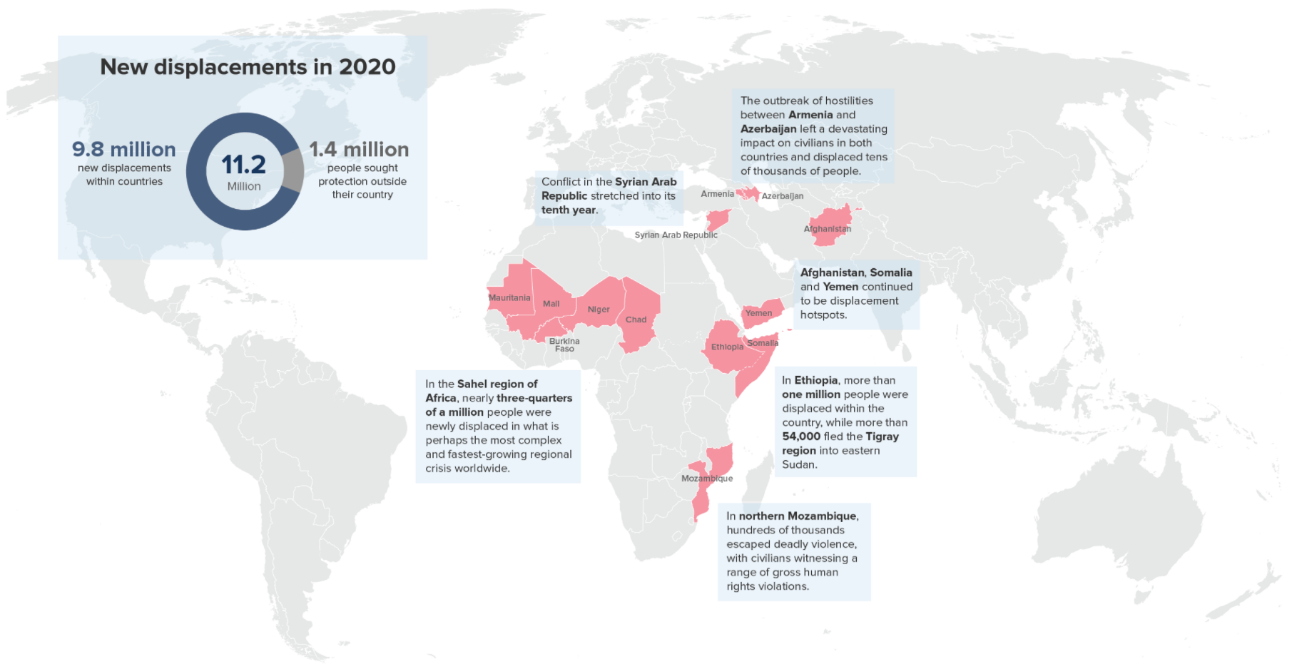
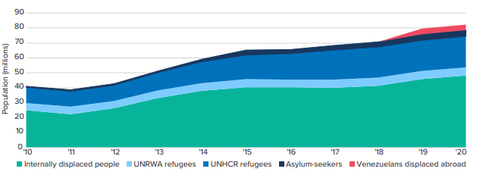
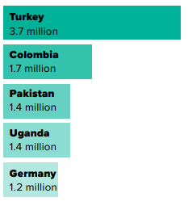
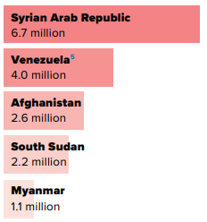
2. Causes, contexts and dynamics of mass displacement Global trends on forced displacement
Section 2. Causes, contexts and dynamics of mass displacement
Absolute numbers of displaced persons over time (in millions)
New displacement crises in 2020
Countries hosting the highest numbers of refugees (absolute numbers)
Most common countries of origin among displaced persons who have crossed a country border
Notes:
Global trends on forced displacement
How much mass is there in mass displacement? When speaking about mass displacement on a global scale, it may be difficult to get an accurate grasp of the quantity of people on the move. And we have previously talked about preconceived ways of referring to the movements of people, such as that there is a ”tidal wave” of migration or that migration has reached unpresedented levels (despite proportionally having remained pretty much the same throughout the last decades).
As emphasized in Module 1, inaccuracies and misconceptions are best counteracted by resorting to reliable data and statistics. Luckily for us, the UNHCR each year compiles relevant data on the global trends of forced displacement. Here is a selection of what the UNHCR has to say about displacement in 2020, and which may serve to give you an idea of what displacement looks like on a global scale:¹⁵
At the end of 2020, there were 82.4 million forcibly displaced persons worldwide. These have been displaced as a result of persecution, conflict, violence, human rights violations or events seriously disturbing public order.
Out of these 82.4 million, 52.8 million were refugees of various kinds, 48 million count as internally displaced persons, 4.1 million are asylum seekers, and another 3.9 million are Venezuelans displaced abroad because of the country’s dire economic and political situation.
A majority (86 percent) of displaced persons are hosted in developing countries, i.e. some of the poorest countries in the world. Turkey, Colombia, Pakistan, Uganda and Germany are the five countries who host the highest number of displaced persons. Relative to their national populations. Aruba, Lebanon, Curacao, Jordan and Turkey host the largest number of refugees in absolute terms.
Out of the displaced persons who have crossed a country border, 73% are hosted in countries neighbouring their country of origin. Poor countries near conflict areas or areas susceptible to environmental disasters thus carry a great proportion of the burden with respect to handling displaced populations.
68 percent of the displaced persons who have crossed a country border originate from only five countries: Syria, Venezuela, Afghanistan, South Sudan and Myanmar.
While the above numbers are specific to 2020, they give an idea of current displacement trends. If we mentioned in Module 1 that the absolute number of migrants overall has risen slightly over time, the absolute numbers of displaced persons have experienced an even sharper increase. In fact, today’s numbers of displaced persons are more than double the level a decade ago (in 2010, 41 million persons were counted as forcibly displaced).¹⁶ This means that the proportion of displaced persons to the rest of the population now is 1 in 95, as compared with 1 in 159 in 2010. A number of crises have contributed to this drastic increase in displacement: the Syrian Arab Republic, which now is stretching into its tenth year; the Bolivarian Republic of Venezuela; the Sahel region of Africa; Afghanistan; Somalia; Ethiopia; Yemen; the Democratic Republic of Congo; Mozambique; Ukraine; and hostilities between Armenia and Azerbaijan.¹⁷ Displacement thus occurs in all the corners of the world.
The above visuals showcase some of the information and data that can be accessed via the UNHCR website with regards to displacement, and which is elaborated upon in more detail in the UNHCR annual report on global trends in forced displacement.

Slide 9
3. Legal, policy and institutional frameworks Frameworks specifically focusing on forcibly displaced persons
Section 3. Legal, policy and institutional frameworks
1951 Convention relating to the Status of Refugees and the associated 1967 Protocol relating to the Status of Refugees
1990 International Convention on the Protection of the Rights of all Migrants and Members of Their Families
1998 Guiding Principles on Internal Displacement together with the 2006 Protocol on the Protection and Assistance to internally Displaced Persons as well as the 2009 African Convention on Protection and Assistance for Internally Displaced Persons in Africa
Frameworks focusing on the rights of refugees and internally displaced persons
2000 Protocol to Prevent, Suppress and Punish Traficking in Persons, Especially Women and Children
2000 Protocol against the Smuggling of Migrants by Land, Sea and Air
1954 Convention relating to the Status of Stateless Persons
1961 Convention on the Reduction of Statelessness
Additional frameworks supporting the rights of trafficked and stateless persons
Notes:
Frameworks specifically focusing on forcibly displaced persons
As is made evident by the above list, plethora of international instruments, conventions, protocols and guiding principles exist, which serve to identify, define and separate populations of people who have been forcibly displaced and which form the basis of the international normative and legal frameworks on international migration. In addition to the ones listed above, there is also the Kampala Convention, the Nansen Initiative, the Global Compact on Refugees and the Global Compact on Migration. While none of these are legally binding, they are still important mechanisms in international relations.
The two most important frameworks with regards to refugees and internally displaced persons are the 1951 Convention relating to the Status of Refugees and the 1998 Guiding Principles of Internal Displacement:
1951 Convention relating to the Status of Refugees.¹⁸ The 1951 Refugee Convention and its 1967 Protocol are the key legal documents that form the basis of the work of the UN’s refugee agency, UNHCR. 149 states are parties to either one or two of the documents, and they outline both the rights of refugees as well as the legal obligations of the states to protect the refugees. The core principle in both documents is that of non-refoulement, i.e. that a refugee should not be returned to a country where he or she faces serious threats to his or her life or freedom. This principle is now considered a rule of customary international law. According to the documents, states are also expected to cooperate with the UNHCR in ensuring that the rights of refugees are respected and protected.
1998 Guiding Principles on Internal Displacement.¹⁹ The Guiding Principles were developed in the 1990s, when civil wars and human rights abuses made evident that people displaced within their own countries were in need of a protection regime, as they were not covered by the 1951 Convention. The Principles set forth 30 principles which outline the rights of internally displaced people and the responsibilities of national governments to protect and assist them. They detail the guarantees relevant to the protection of and assistance to internally displaced persons during their displacement and until their achievement of durable solutions (for instance by return, reintegration or settlement elsewhere in the country). The Guiding Principles also cover protections against arbitrary displacement as well as emphasize the primary responsibility of national authorities for protecting and assisting all internally displaced persons, regardless of the cause of their displacement.

Slide 10
3. Legal, policy and institutional frameworks Human rights frameworks
Section 3. Legal, policy and institutional frameworks
1948 Universal Declaration of Human Rights
1948 Convention on the Prevention and Punishment of the Crime of Genocide
1966 International Coventant on Civil and Political Rights
1966 International Covenant on Economic, Social and Cultural Rights
1966 International Convention on the Elimination of All Forms of Racial Discimination
1979 Convention on the Elimination of All Forms of Discimination against Women
1984 Convention against Torture and Other Cruel, Inhuman or Degrading Treatment or Punishment
1989 Convention on the Rights of the Child
Frameworks on the human rights of all people
Notes:
Human rights frameworks
In addition to frameworks specifically focusing on the rights of displaced people, a range of frameworks exist which set forth the rights that apply to all human beings, regardless of their status. Together, they provide the legal, policy and institutional framework for how states and other international actors (e.g. non-governmental or international organisations) are to treat persons who have been forcibly displaced. In addition, many countries have their own national laws which stipulate how displaced persons within their territories are to be treated, although many countries incorporate the international frameworks into their national legislation.
Perhaps the biggest milestone in the history of human rights was the drafting of the 1948 Declaration of Human Rights. It for the first time sets out fundamental human rights to be universally protected and was drafted by representatives with different legal and cultural backgrounds from all regions of the world. The background was the experience of the Second World War, and the realization that such atrocities should never be commited again.²⁰
The Declaration of Human Rights is generally agreed to be the foundation of international human rights law and has inspired a rich body of legally binding international human rights treaties.²¹ These treaties protect the rights of human beings by laying down obligations which states are bound to respect if they become parties to said treaties. States thus assume the duty to respect, protect and fulfil human rights, which means that they must refrain from interfering with or curtailing the enjoyment of human rights, that they are required to protect individuals and groups against human rights abuses and that they must take positive action to facilitate the enjoyment of basic human rights.²² States are thus required to refrain from actions that may interfere with the human rights of people, but must simultaneously actively facilitate the enjoyment of the rights, for instance by protecting people from the infringement of their rights by other actors, or making sure that the appropriate legal procedures to protect the rights are in place. Where states fail to address human rights abuses, mechanisms and procedures for individual and group complaints are available at the regional and international levels to help ensure that international human rights standards are indeed respected, implemented, and enforced at the local level.

Slide 11
3. Legal, policy and institutional frameworks When is displacement unlawful? And what is the responsibility of the state?
Section 3. Legal, policy and institutional frameworks
When is displacement unlawful?
When based on apartheid or ethnic cleansing
In situations of armed conflict
In cases of large-scale development projects
In cases of disasters
When used as collective punishment
What is the responsibility of the state?
Prevent/avoid conditions causing displacement
Refrain from forcing people to leave
Minimize the scale of displacement and its effect
Find durable solutions for the displaced
Advocate with parties to armed conflicts
Notes:
When is displacement unlawful?²³
While there is no specific right to protection against forced displacement as such, it is inherent in a number of human rights, including the rights to freedom of movement and choice of residence, the right to respect for the home and for privacy, the right to an adequate standard of living, including food and housing, and the right to respect for the family. Forced displacement is only permissible on an exceptional basis and for a limited number of reasons. It is important to underline that, when discussing the legality of forced displacement, it is always the act of ordering or forcing displacement (usually by an authority or an armed group) that is called into question and not the act of fleeing by those being displaced (this in itself is never unlawful).
The act of displacing individuals or populations is always unlawful:
When it is based on policies of apartheid, ethnic cleansing or similar practices aimed at/or resulting in altering the ethnic, religious or racial composition of the affected population
In situations of armed conflict, unless the security of the civilians involved or imperative military reasons so demand
In cases of large-scale development projects which are not justified by compelling and overriding public interests
In cases of disasters, unless the safety and health of those affected requires their evacuation
And when it is used as collective punishment.
In addition, forced displacement can be unlawful if:
Minimum procedural guarantees are not respected
The manner in which it is carried out violates other rights and/or obligations that apply to the state or a party to the conflict, such as the rights to liberty and security, and the prohibition against torture, inhuman and degrading treatment
It negatively impacts the enjoyment of human rights for the long term.
The responsibility of the state²⁴
The state and its institutions have a responsibility to respect and ensure respect for their human rights obligations at all times. In times of conflict, the parties to the conflict are similarly obliged to respect and ensure respect for the rules of international humanitarian law. In preventing displacement and protection the displaced, states should:
Take all possible measures to prevent and avoid conditions that might cause or contribute to forced displacement (for instance, ensuring respect for the rule of law, combating impunity and otherwise creating an environment conducive to the realization of rights)
Refrain from forcing individuals and communities to leave their homes or places of habitual residence and protect them from being arbitrarily displaced by others. Moreover, authorities should seek all possible alternatives before resorting to displacement
When displacement is necessary and justifiable, the authorities must take action to minimize the scale of displacement and mitigate its adverse effects. In particular, the authorities should ensure to the greatest extent possible that it takes place in satisfactory conditions of safety, shelter, nutrition, health and hygiene, and that members of the same family are not separated
Ensure that displacement lasts no longer than required by the circumstances and that a durable solution is found for all those affected. The authorities should aim to create conditions for voluntary return and reintegration and/or settlement elsewhere in the country and facilitate them. Internally displaced persons should not be discriminated against as a result of having been displaced and should be entitled to restitution and/or compensation for property of which they may have been arbitrarily deprived.
Provide protection and assistance to internally displaced persons. Where the national authorities are unable or unwilling to do so, they should ensure rapid and unimpeded access by humanitarian actors to populations in need and facilitate the free passage of humanitarian assistance
Advocate with parties to armed conflicts and take all relevant measures, regardless of the country or countries concerned, to ensure that forced displacement of civilians does not occur unless necessary for their own protection or justified by imperative military reason.

Slide 12
3. Legal, policy and institutional frameworks Questions for reflection
Section 3. Legal, policy and institutional frameworks
Reflect on what you have just learned about the statuses of displaced persons and the various frameworks that apply.
What consequences do you think this may have in practice?
What implications does it have on the lives and needs of displaced people?

Slide 13
4. Stakeholders of mass displacement International organisations with a specific focus on migrants
Section 4. Implications of the terminology
Organisation | Logo | Background | Key mission
UNHCR |  | Established in the aftermath of World War II to protect European refugees | Safeguarding the rights and wellbeing of all refugees , regardless of origin or cause of displacement
UNRWA |  | Established in the aftermath of World War II to protect Palestinian refugees | Focuses in relief and work programmes aiming at protecting Palestinian refugees only
IOM |  | Established in 1951 in response to the large number of internally displaced people in Europe following the Second World War | Facilitates migration worldwide, focusing on migrants in need and situations of vulnerability
Notes:
International organizations with a specific focus on migrants
In addition to a comprehensive legal and policy framework, refugees and internally displaced persons are protected and assisted by various international stakeholders (in addition to, hopefully, the aid that is provided by states themselves). Currently, three organizations exist which have a legal mandate to assist refugees:
The United Nations High Commissioner for Refugees (UNHCR).²⁵ UNHCR was established in 1950 to provide international protection and to seek permanent solutions for refugees in the aftermath of the World War II. Focus was initially on European refugees who had fled because of the war, and it was anticipated that ”finding permanent solutions” would take three years. After that, the organisation would disband. 70 years later the organisation still exists and is probably needed more than ever. It is today the only agency with a mandate to protect refugees, and its key focus is the safeguarding of the rights and wellbeing of refugees as well as ensuring that no person is returned to a country where thay are at risk of persecution. As such, the UNHCR works with several categories of ”Populations of Concern” (which also includes people in precarious or unstable situations but which do not have refugee status) which they focus their safeguarding efforts on.
The United Nations Relief and Works Agency for Palestine Refugees in the Near East (UNRWA).²⁶ As with UNHCR, the UNRWA was established in 1950, however for a different reason. While the UNHCR initially focused on European refugees, the focus on UNRWA was and still is Palestinian refugees, following the Arab-Israeli conflict in 1948. Its focus in direct relief and works programmes for Palestinian refugees especially, for instance including education, health care, social services as well as camp infrastructure and improvements, including in times of conflict. As a permanent solution to the conflict between Israel and Palestina has not been reached, the mandate of UNRWA has been repeatedly renewed since it was established.
The International Organization for Migration (IOM).²⁷ The IOM has been an organisation in its own right for close to seven decades, but became a related agency to the UN in 2016 and is mandated to assist migrants. The organisation plays a key role in facilitating migration worldwide, working with partners to meet operational challenges of migration, enhance understanding of migration, encourage social and economic development via migration as well as uphold the human dignity and wellbeing of migrants. The IOM primarily focuses on migrants in need and in situations of vulnerability, for instance those requiring humanitarian assistance in the aftermath of harsh weather, conflict or persecution, or for those migrants who have become stranded.

Slide 14
5. Summary Key points to remember
Section 6. Summary
Displaced people are placed in various categories. Together with other groups such as stateless people, they constitute Populations of Concern under the UNHCR mandate.
Key categories are refugees and internally displaced persons. The important difference is crossing a state border, and the implications this has in international law and on the obligations of states.
A range of various legal, policy and institutional frameworks exist, both focusing on the specific rights of displaced people and on the rights of humans in general.
Main stakeholders working on protecting the rights of refugees and migrants are the United Nations High Commissioner for Refugees, the United Nations Relief and Works Agency for Palestine Refugees in the Near East and the International Organization for Migration.

Slide 16
1. What description best fits the term ‘internally displaced person’?
A person who has been forced or obliged to leave his or her home of place of habitual residence and who has not crossed an internationally recognized state border
A person who has been forced or obliged to leave his or her home of place of habitual residence and who has not crossed an internationally recognized state border, but who has since then returned to his or her place of residence
A person who has been forced or obliged to leave his or her home of place of habitual residence and who has crossed an internationally recognized state border
A person who has been forced or obliged to leave his or her home of place of habitual residence and who has crossed an internationally recognized state border, but who has since then returned to his or her place of residence

Slide 17
2. How much has the number of forcibly displaced persons globally increased from 2010 to 2020?
From around 95 million to around 159 million people
From around 41 million to around 52 million people
From around 41 million to around 82 million people
The number has not increased, the number of forcibly displaced persons has remained stable over time.

Slide 18
3. Which of the following options are correct with regards to the responsibility of the state in situations of mass displacement?
The state does not only have to refrain from forcing individuals and communities to leave, but it also has to protect its residents from being displaced by the actions of other actors
The obligations of the state with regards to displacement hold true only for those displacees who are fleeing to the country from another country
There are certain cases when displacement is necessary and justifiable. In such cases, the state’s obligation is to ensure only the immediate safety of the displacees
The state should take all possible measures to prevent and avoid conditions that might cause or contribute to forced displacement, but does not have to collaborate with other actors in doing so if it doesn’t want to

Slide 19
4. In what situation is displacement not unlawful?
In cases of large-scale development projects which are not justified by compelling and overriding public interests
When the displacement is used as collective punishment of a minority group who is in conflict with the majority group of the country
In situations of armed conflict where the security of the civilians involved or imperative military reasons demand the displacement from a certain area
When the state demands the evacuation of a certain area as a precautionary measure taken to prevent disasters, but in doing so the state fails to respect the human rights of the evacuees

Slide 20
5. Which three international organizations are legally mandated to assist refugees?
1. -----------------------------------------------------------------------------------------------------------
2 . -----------------------------------------------------------------------------------------------------------
3 . -----------------------------------------------------------------------------------------------------------

Slide 21
References
International Organization for Migration (2019). Glossary on Migration. Retrieved from https://publications.iom.int/system/files/pdf/iml_34_glossary.pdf [retrieved 210907]. P. 55
The United Nations High Commissioner for Refugees (2020). Global Trends: Forced Displacement in 2020. Retrieved from UNHCR Global Trends - Forced displacement in 2020 [retrieved 210925], p. 4
International Organization for Migration (2019). Glossary on Migration. Retrieved from https://publications.iom.int/system/files/pdf/iml_34_glossary.pdf [retrieved 210907]. P. 171
International Organization for Migration (2019). Glossary on Migration. Retrieved from https://publications.iom.int/system/files/pdf/iml_34_glossary.pdf [retrieved 210907]. P. 170
International Organization for Migration (2019). Glossary on Migration. Retrieved from https://publications.iom.int/system/files/pdf/iml_34_glossary.pdf [retrieved 210907]. P. 170
International Organization for Migration (2019). Glossary on Migration. Retrieved from https://publications.iom.int/system/files/pdf/iml_34_glossary.pdf [retrieved 210907]. P. 171-172
International Organization for Migration (2019). Glossary on Migration. Retrieved from https://publications.iom.int/system/files/pdf/iml_34_glossary.pdf [retrieved 210907]. P. 171
International Organization for Migration (2019). Glossary on Migration. Retrieved from https://publications.iom.int/system/files/pdf/iml_34_glossary.pdf [retrieved 210907]. P. 109
The United Nations High Commissioner for Refugees. The 1951 Refugee Convention. Retrieved from https://www.unhcr.org/1951-refugee-convention.html [retrieved 210927]
Castles, Stephen (2006). Global Perspectives on Forced Migration. In Asian and Pacific Migration Journal, Vol. 15 No. 1, p 11-12
World Vision. Syrian Refugee Crisis: Facts, FAQs and How to Help. Retrieved from Syrian refugee crisis: Facts, FAQs, and how to help | World Vision [retrieved 210927]
The United Nations High Commissioner for Refugees (2019). Refugee Movements in South-East Asia 2018 – June 2019. Retrieved from https://www.unhcr.org/5d91e2564.pdf [retrieved 20210927]
Migration Policy Institute (April 10, 2020). Venezuelan Immigrants in the United States. Retrieved from https://www.migrationpolicy.org/article/venezuelan-immigrants-united-states-2018 [retrieved 210927]
Internal Displacement Monitoring Centre (January 2020). Behind the Numbers: The Shadow of 2010’s Earthquake still Looms Large in Haiti. Retrieved from https://www.internal-displacement.org/expert-opinion/behind-the-numbers-the-shadow-of-2010s-earthquake-still-looms-large-in-haiti [retrieved 210927]
The United Nations High Commissioner for Refugees (2020). Global Trends: Forced Displacement in 2020. Retrieved from UNHCR Global Trends - Forced displacement in 2020 [retrieved 210925], p. 2-3
The United Nations High Commissioner for Refugees (2020). Global Trends: Forced Displacement in 2020. Retrieved from UNHCR Global Trends - Forced displacement in 2020 [retrieved 210925], p. 6
Migration Data Portal (30 June 2021). Forced Migration or Displacement. Retrieved from https://www.migrationdataportal.org/themes/forced-migration-or-displacement [retrieved 210927]
The United Nations High Commissioner for Refugees. The 1951 Refugee Convention. Retrieved from https://www.unhcr.org/1951-refugee-convention.html [retrieved 210927]

Slide 22
References
Global Protection Cluster. Fact Sheet on the Guiding Principles on Internal Displacement. Retrieved from https://www.globalprotectioncluster.org/gp20/fact-sheet-on-the-guiding-principles-on-internal-displacement/ [retrieved 210927]
The United Nations. Universal Declaration of Human Rights – History of the Declaration. Retrieved from https://www.un.org/en/about-us/udhr/history-of-the-declaration [retrieved 210927]
The United Nations. Universal Declaration of Human Rights – The Foundation of International Human Rights Law. Retrieved from The Foundation of International Human Rights Law | United Nations [retrieved 210927]
The United Nations. Universal Declaration of Human Rights – The Foundation of International Human Rights Law. Retrieved from The Foundation of International Human Rights Law | United Nations [retrieved 210927]
The United Nations High Commissioner for Refugees. Handbook for the Protection of Internally Displaced Persons. Retrieved from https://www.unhcr.org/protection/idps/4c2355229/handbook-protection-internally-displaced-persons.html [retrieved 210930]. P. 138
The United Nations High Commissioner for Refugees. Handbook for the Protection of Internally Displaced Persons. Retrieved from https://www.unhcr.org/protection/idps/4c2355229/handbook-protection-internally-displaced-persons.html [retrieved 210930]. P. 140
https://www.unhcr.org/ [retrieved 210930]
https://www.unrwa.org/ [retrieved 210930]
https://www.iom.int/ [retrieved 210930]

