Slide 1
Planning and designing public places

Slide 2
Learning outcomes
By the end of this lesson, students will:
Know the meaning of public places.
Know the importance of public places.
Understand the role of planners in creating public places..
Recognise the importance of planning and designing public places.

Slide 3
Content
What is public places?
What are the importance of creating public places?
The role of planners in creating public places?
What are the importance of planning and designing public places?
Conclusion.
References.

Slide 4
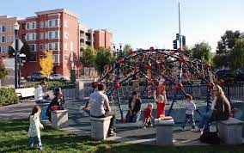
What are public places?
Areas that are accessible by the members of the public which can be rural, urban, suburban and wilderness landscapes.
It does not relate to ownership but to use (see Altman & Zube, 2012
Public places
These areas are accessible to everyone – people of a community, state, nation regardless of age, gender, ethnicity, physical handicap or other characteristics
Places made for the public and it include somewhere to rest, hang out, or play (Carmona, 2019).

Slide 5
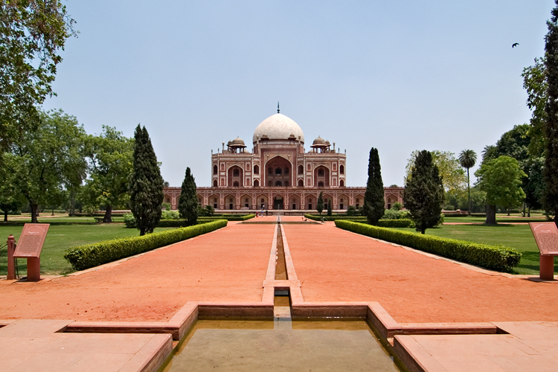
What are the importance of creating public places?
Public places are centres of settlements and relaxations for all types of people.
They are central places where public life, events, and activities are focused (Carmona, (2019).
Places where people gather for the everyday marketplace; it is also a hub for the exchange of social, political and artistic developments (Architecture and more, ND).
It enhances social activities and cohesion,
Resettlement planning requires strategic planning and designing is required to make public places attractive and of paramount convenience.

Slide 6
The role of planners in creating public places
Planners plays a major role in the creation and shaping of public places namely:
They understand how to use plans, frameworks, and policies
They understand the need as well as the potential for new or regenerated public places in particular locations
Planners often initiate the public space projects
Planners through the regulatory processes of development management, offers directions on how public places can be created, regenerated, and established (Carmona, 2019).

Slide 7
What are the importance of planning and designing public places?
It is important in providing the displaced with an environment that can help to facilitate their quality of life
Planning and designing public places are integral part of the resettlement process.
This reaffirms the statement made by William H. Whyte that “The way we build cities, the way we make places, can have a profound effect on what kinds of lives are lived within those spaces” (Energised public spaces, 2018).

Slide 8
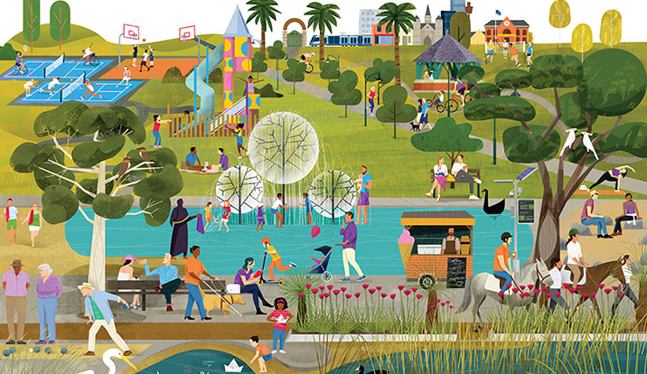
Conclusion
Planning and designing public places are integral part of the resettlement process.
It helps to enhance the quality of life of the displace as they relate and interact with each other daily.

Slide 9
References
Architecture and more (ND). Importance of public places. Available online: http://squareone.blog/importance-of-public-places-in-cities/. Assessed on: 26/)1/2022.
Altman, I., & Zube, E. H. (Eds.). (2012). Public places and spaces (Vol. 10). Springer Science & Business Media.
Carmona, M. (2019). Principles for public space design, planning to do better. Urban Design International, 24(1), 47-59.
Energised Public spaces (2018). Designing Public Spaces Energized Public Spaces Design Guidelines Working Draft December 2018. THE MONTGOMERY COUNTY DEPARTMENT OF PARKS THE MARYLAND-NATIONAL CAPITAL PARK AND PLANNING COMMISSION Available online at: https://montgomeryplanningboard.org/wp-content/uploads/2019/01/Attachment_A_EPS_Design_Guidelines_Working_Draft.pdf. Asseesed on: 18/01/2022.

