Slide 1
Infrastructure and service provision

Slide 2
Learning outcomes
Understand the meaning of infrastructure.
Know the types of infrastructure
Be able to explain what service provision means.
Analyse infrastructure and service provisions for the resettled: the built environment
Know the importance of infrastructure and service provision in resettlement housing

Slide 3
Content
What is infrastructure?
The types of infrastructure.
The meaning of service provision
Infrastructure and service provisions for the resettled: the built environment.
The importance of infrastructure and service provision in resettlement housing.
Conclusion.
References.

Slide 4
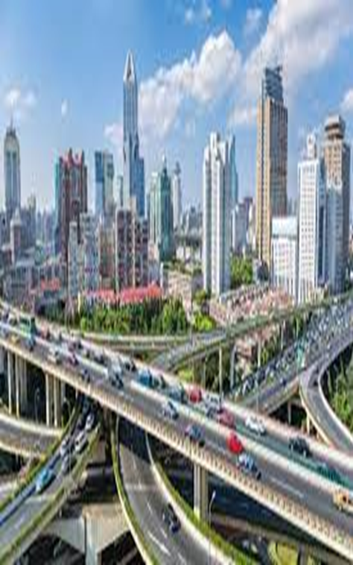
What is infrastructure?
It is the sum of material, institutional and personal facilities and data which are available to the economic agents, and which contribute to realizing the equalization of the remuneration of comparable inputs in the case of a suitable allocation of resources, that is complete integration and maximum level of economic activities" (Jochimsen, 1966: 100: as quoted in Buhr, Walter (2003).
INFRASTRUCTURE
It refers to fundamental physical and technological frameworks established by a region, a country, an organisation or institution for the effective functioning of its economy; it is critical to the economic stability of a country and helps to make people’s lives easier, sustainable, and more comfortable lives . (https://www.wallstreetmojo.com/infrastructure/).

Slide 5
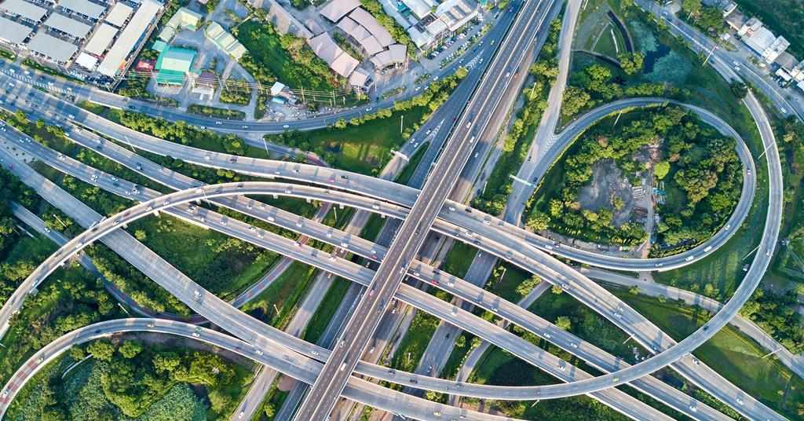
Types of infrastructure
Hard infrastructure (Physical) - includes physical networks, such as roads, railroads, telecommunication services, etc., necessary for an industrialized nation to function
Personal infrastructure - human capital and the relevant properties of the working population such as education, qualification in different functions (Buhr, 2003)
Material infrastructure - capital goods such as transportation, education, and health facilities, equipment of energy (Buhr, 2003
Soft infrastructure (Institutional) - structures aim at encouraging the economic, social, health, cultural, and environmental standards of a nation ((Buhr, 2003) & Source: Infrastructure (https://www.wallstreetmojo.com/infrastructure/).
Critical infrastructure - Government assets that are critical to the smooth operation of a society or an economy. Examples are human shelters, heating facilities, telecommunication, public health etc (Source: Infrastructure https://www.wallstreetmojo.com/infrastructure/).

Slide 6
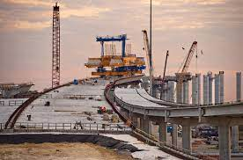
Service provision
Service provision is an act of providing individuals and communities with access to quality infrastructure that are vital parts of supporting their sustainability and resilience, this includes renewing outdated infrastructure and supporting the delivery of new ones services to these communities (Greg, Sean & Laura, 2019).
Based on this, service provision in the context of resettlement housing can be seen as the provision of the basic and essential infrastructure that can facilitate the successful settlement of the displaced as well as assist for their quick restoration.

Slide 7
Infrastructure and service provisions for the resettled: the built environment
The importance of the provision of adequate infrastructure and services for the displaced cannot be over emphasised;
The built environment plays a significant role in the creation of resilience and reduction of vulnerability of disasters and displacement through infrastructure and service provision.
The built environment can create resilience via the basic roles of constructing, developing, stimulating, facilitating, protecting, and nurturing the environment (Haigh and Amaratunga, 2011).
With these roles, the built environment professionals can provide the infrastructure and services geared towards enhancing the resilience of communities and cities. Understanding what constitutes a better built infrastructure and services is as important as creating such services.

Slide 8
The importance of infrastructure and service provision in resettlement housing
Increased flow of the displaced into the cities with projection showing that by 2050 68% of the world’s population will live in cities;
With majority inhabiting the unbuilt environment (Earle & Goh, 2020).
Hence, the dire need for adequate infrastructure and service provision to the resettled.
It facilitate the achievement of the SDGS, Earle & Goh (2020) affirm that the built environment is critical to international development and to the achievement of the SDGs.
Based on this, countries that are targeting to achieve the SDGs, should understand the importance of infrastructure and service provision in the context of the built environment.
The provision facilitate the successful resettlement and quick recovery of the displaced.

Slide 9
Conclusion
Indeed, the provision of infrastructure and services to the displaced and resettled is an integral part of their recovery process.
Considering the unprecedented rate of forced displacement in recent times, the built environment professionals have a role to play towards planning and preparing for this upsurge of the displaced population.

Slide 10
References
Earle, L. & Goh, K. (2020). Overview of the Built Environment Research Landscape and Funder Recommendations. Available on line at: https://www.ukcdr.org.uk/wp-content/uploads/2020/02/IIED-UKDCR-0902-Report-Built-Environment.pdf. Assessed on: 13/01/2022.
Buhr, Walter (2003) : What is infrastructure?, Volkswirtschaftliche Diskussionsbeiträge, No. 107-03, Universität Siegen, Fakultät III, Wirtschaftswissenschaften, Wirtschaftsinformatik und Wirtschaftsrecht, Siegen.
Source: Infrastructure - https://www.wallstreetmojo.com/infrastructure/
Greg Halseth, Sean Patrick Markey, Laura Ryser (2019). Service Provision and Rural Sustainability: Infrastructure and Innovation. Routledge.
Haigh and Amaratunga. (2011). Adopted from McKnight, J., & Kretzmann, J. (1993). Building communities from the inside out. A path toward finding and mobilizing a community’s assets

